Slide 1
CONTEMPORARY SLIPWARE
INTERNATIONAL SLIPWARE SYMPOSIUM
AEGINA 2021

Slide 2
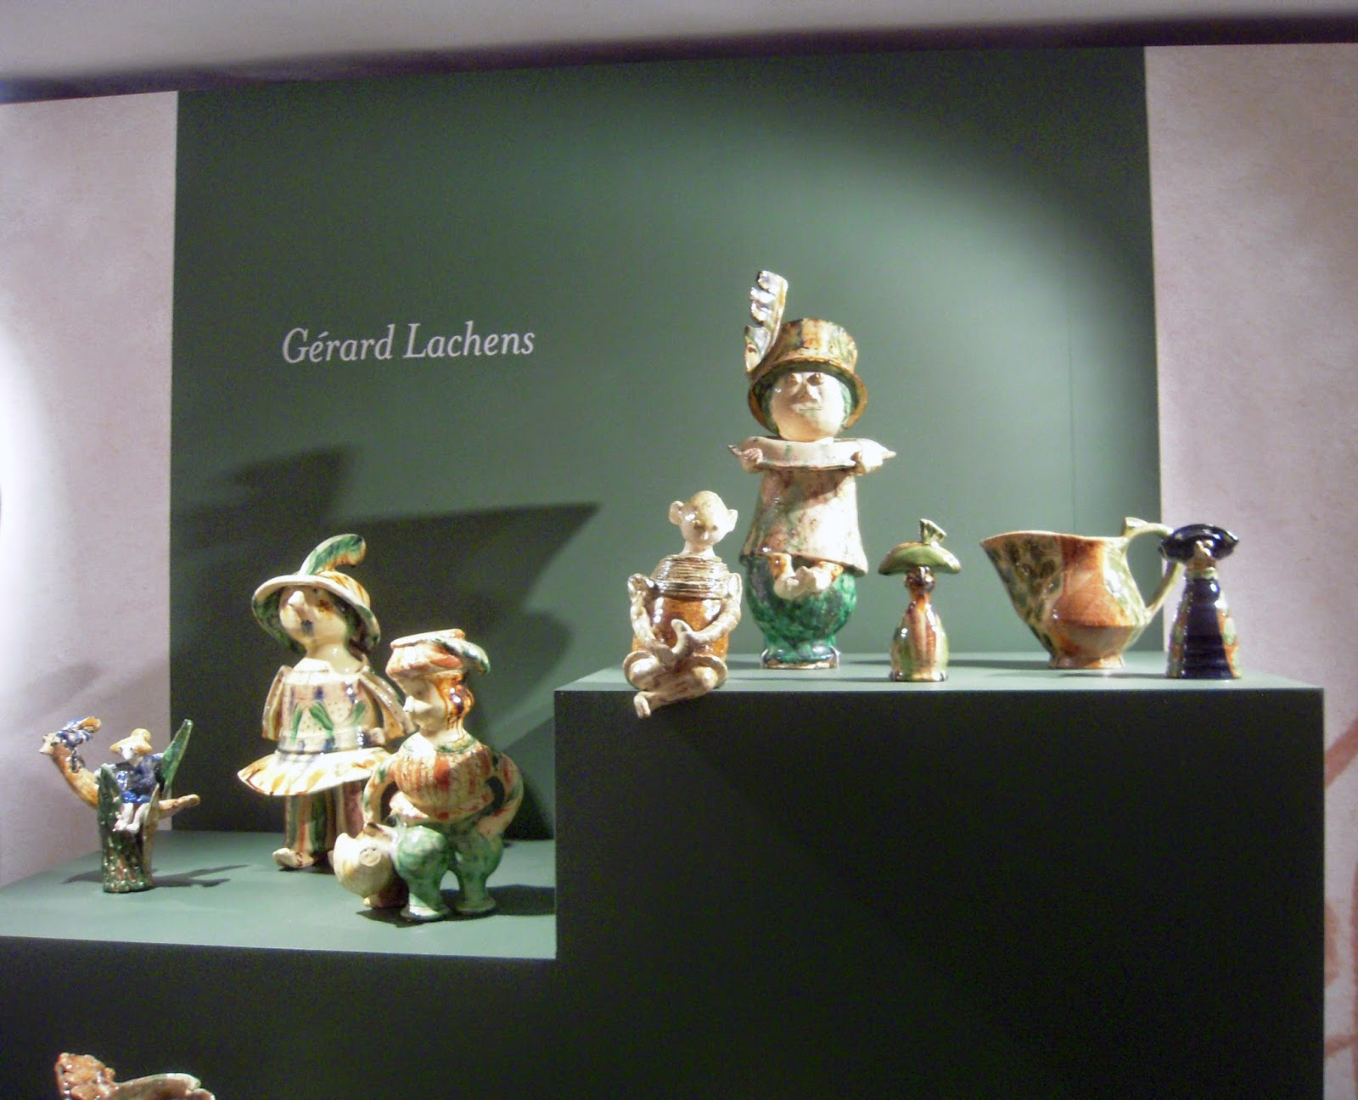

Slide 3
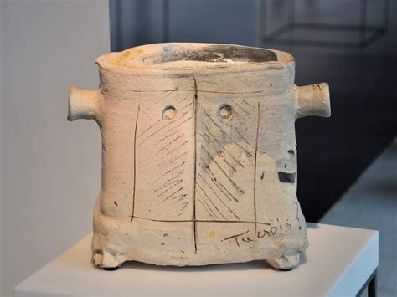
MICHEL GARDELLE

Slide 4
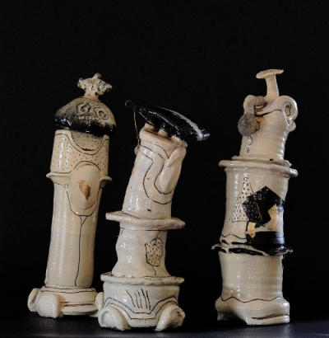

Slide 5
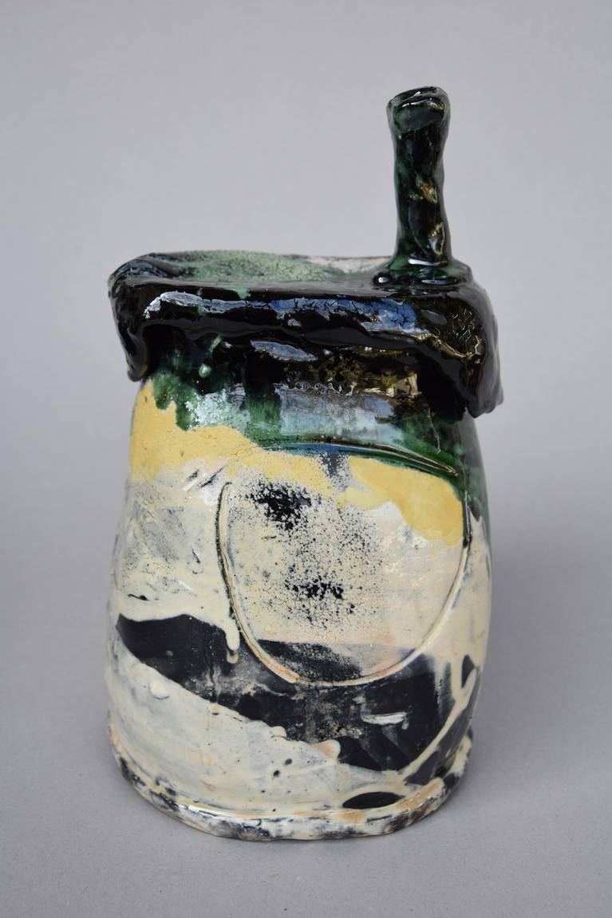
g

Slide 6
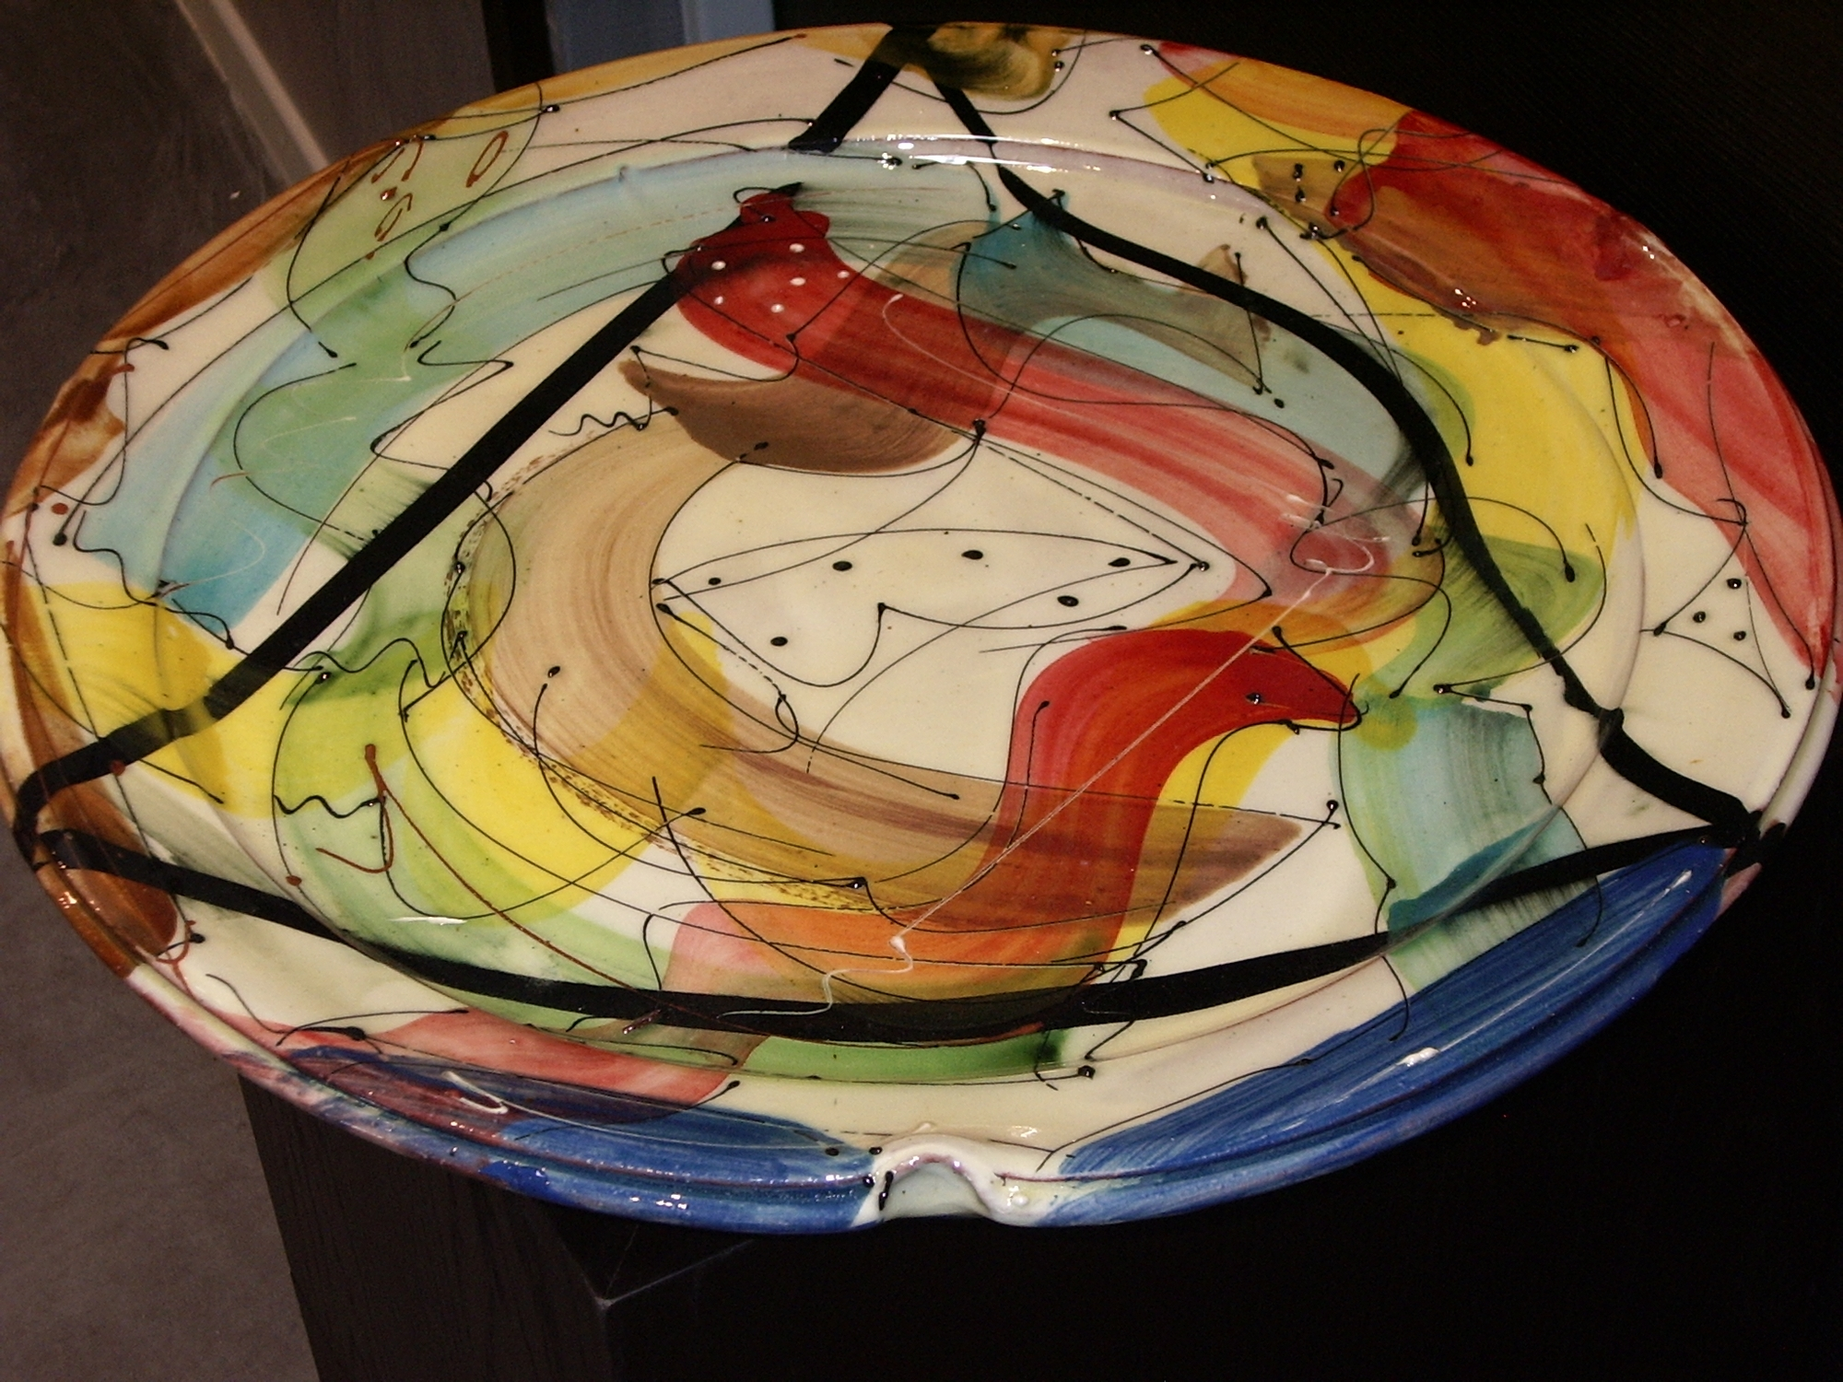
DAVID MILLER

Slide 7
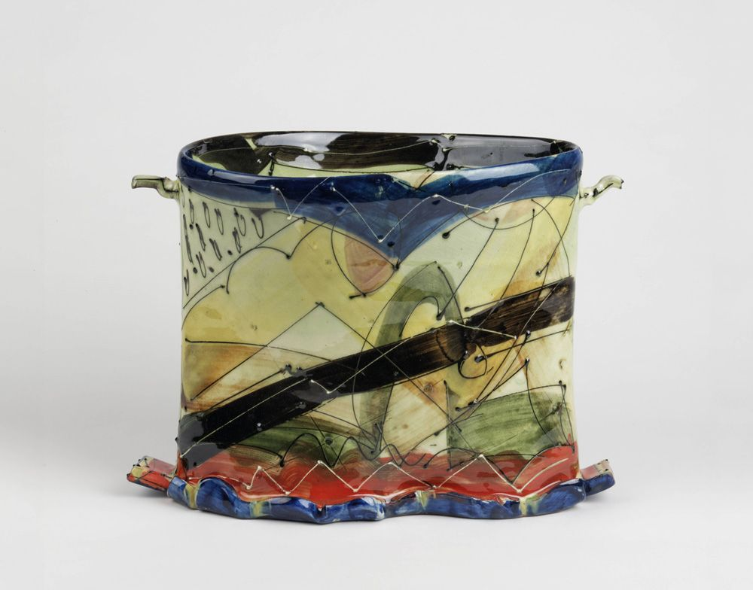

Slide 8
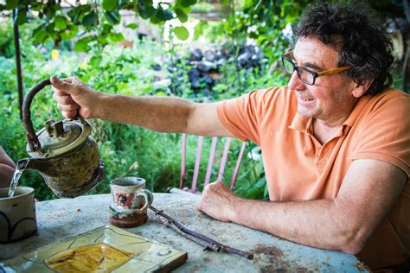
JEAN-NICOLAS GERARD

Slide 9
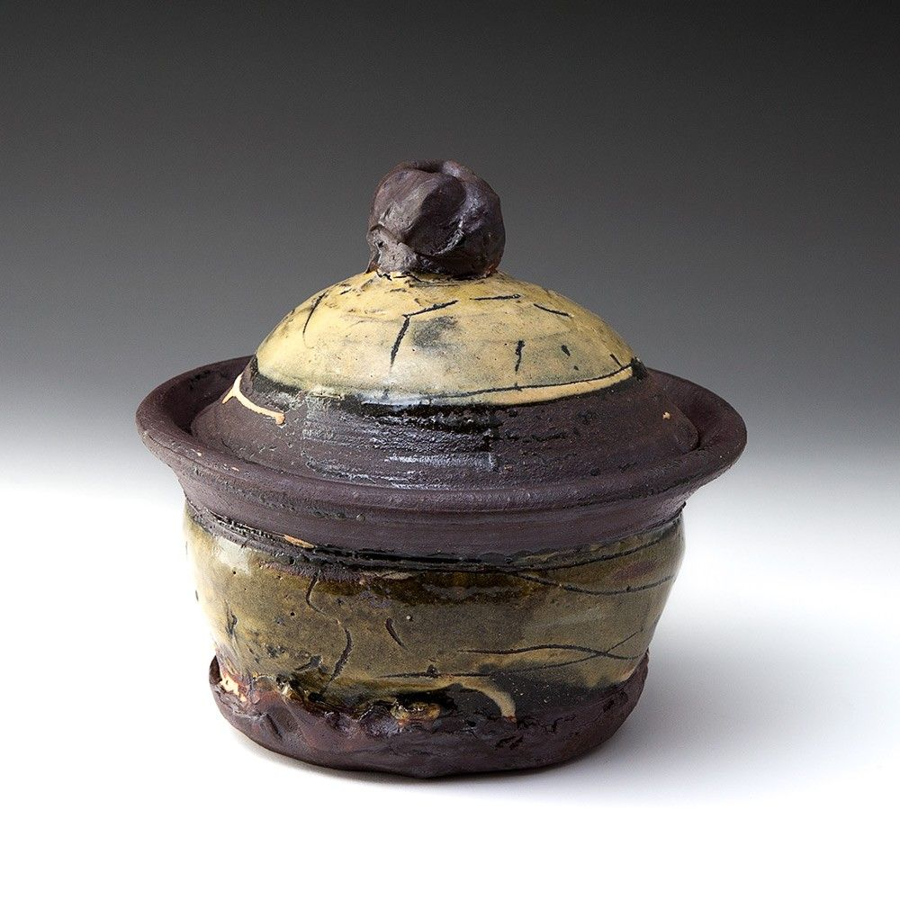

Slide 10
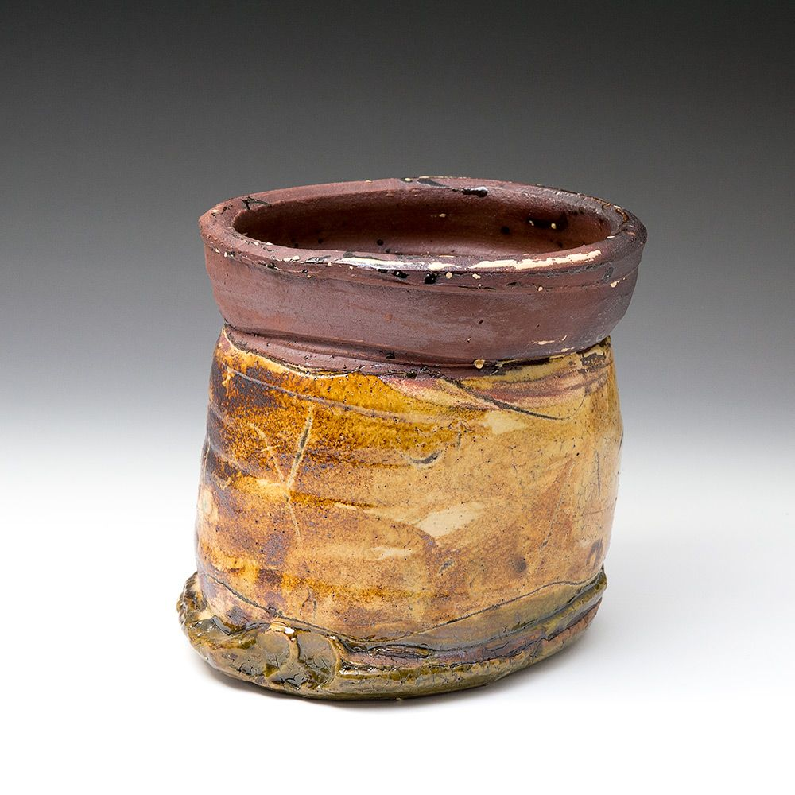

Slide 11
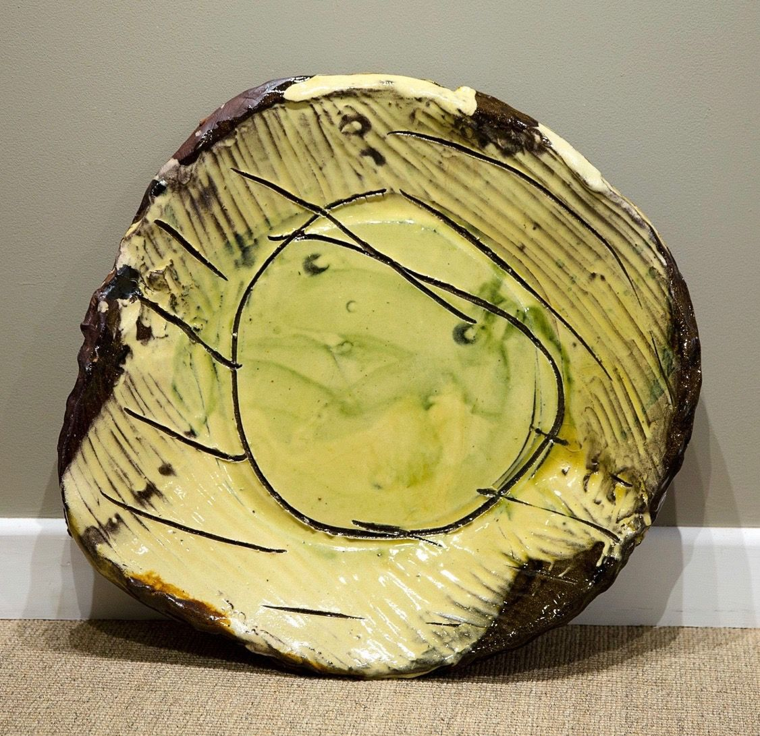

Slide 12
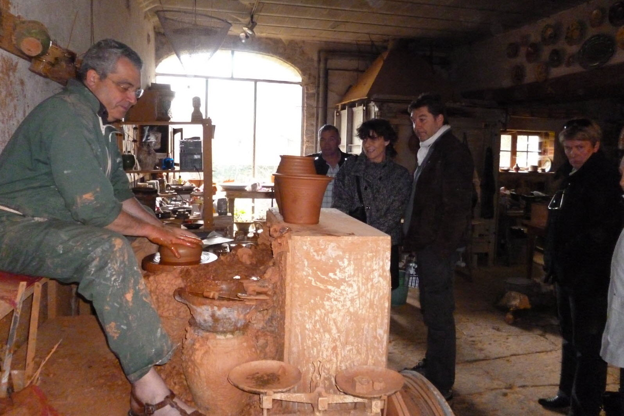
FRANÇOIS FRESNAIS

Slide 13
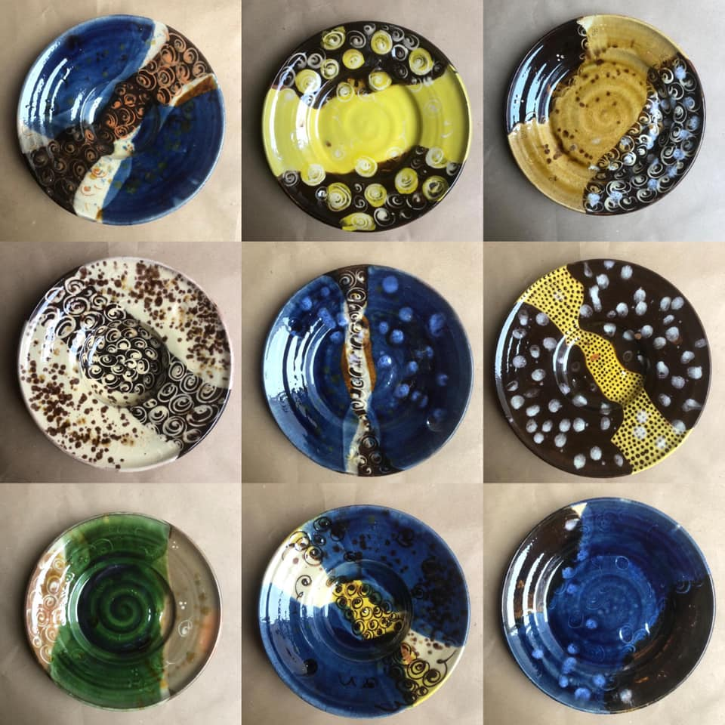

Slide 14
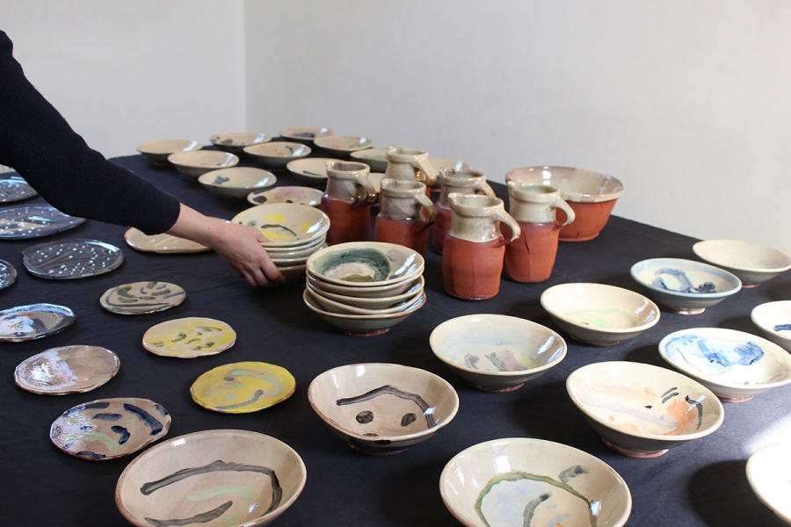
HELOISE BARIOL

Slide 15
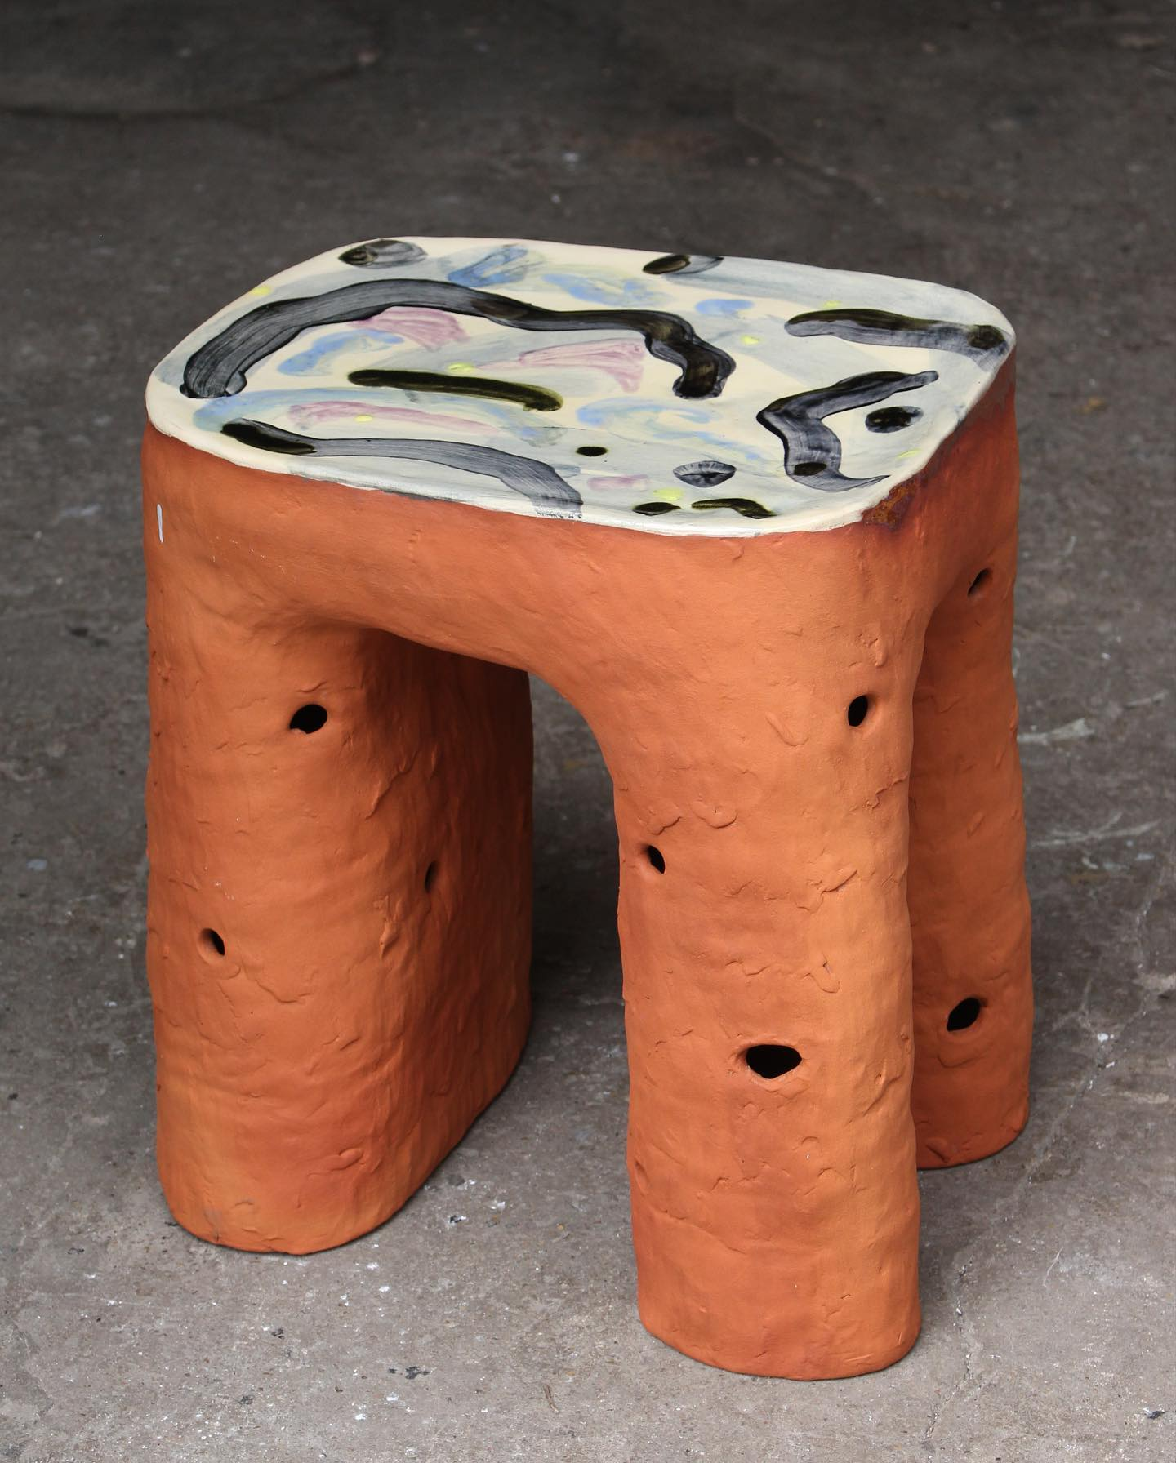

Slide 16
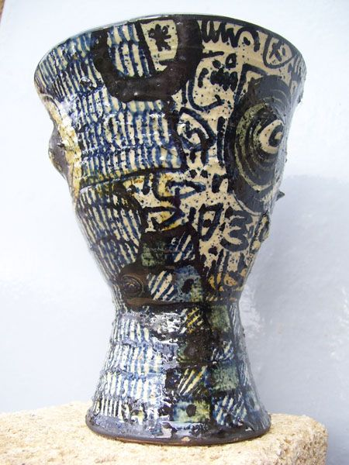
JEROME GALVIN

Slide 17
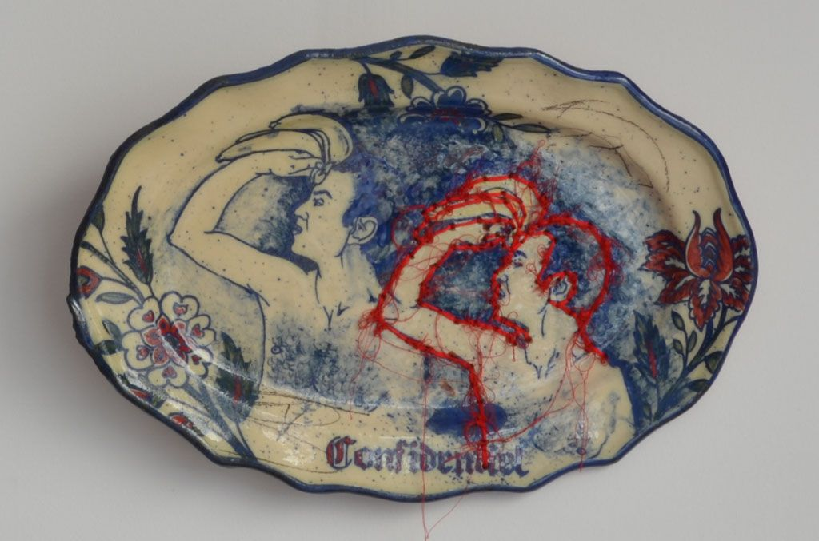

Slide 18
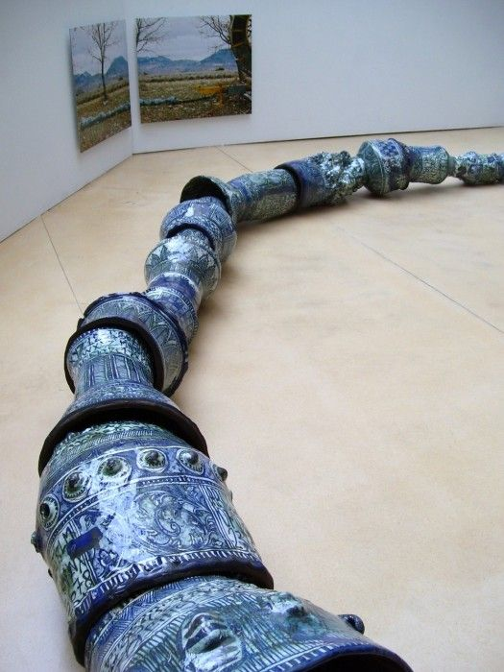

Slide 19
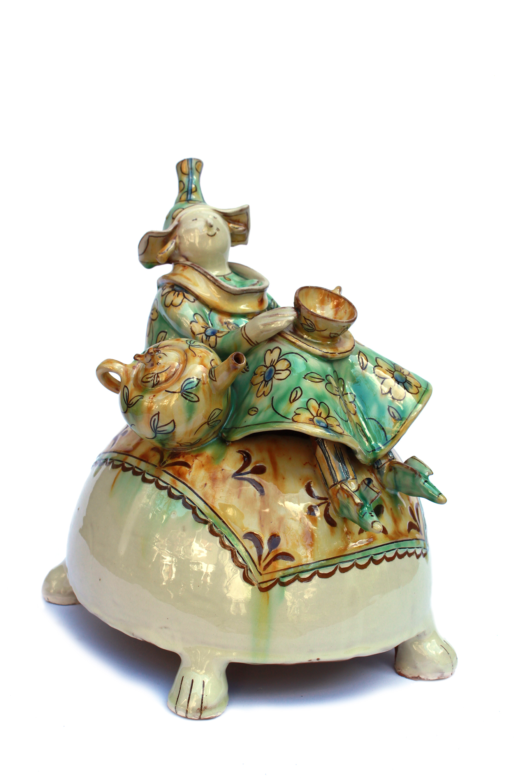
HÉLÈNE AMOUDRUZ

Slide 20
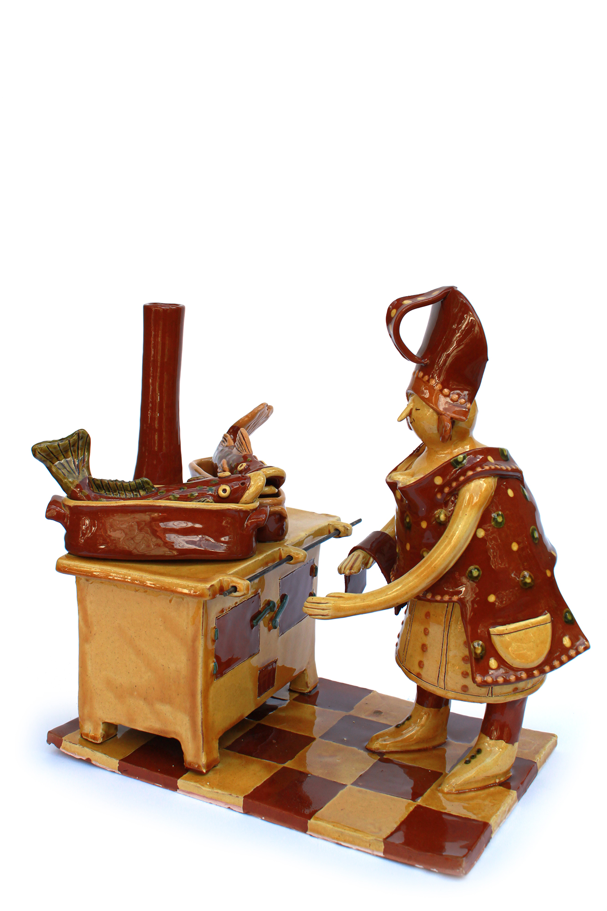

Slide 21
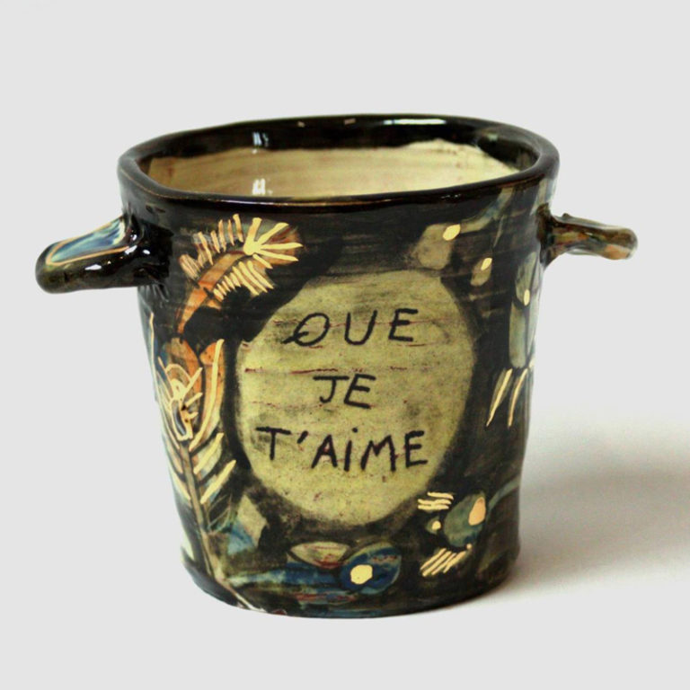
MARIE DELAFOSSE

Slide 22
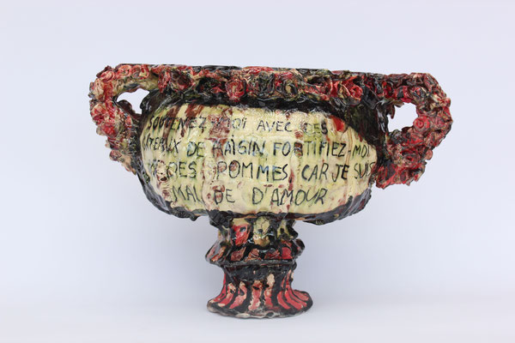

Slide 23
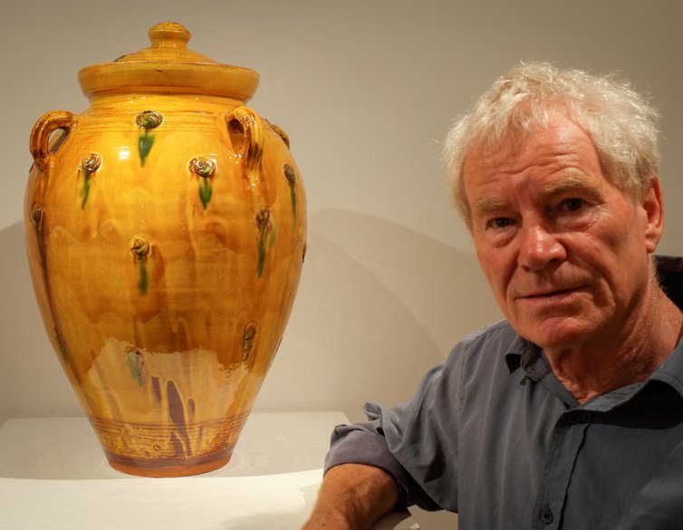
CLIVE BOWEN

Slide 24
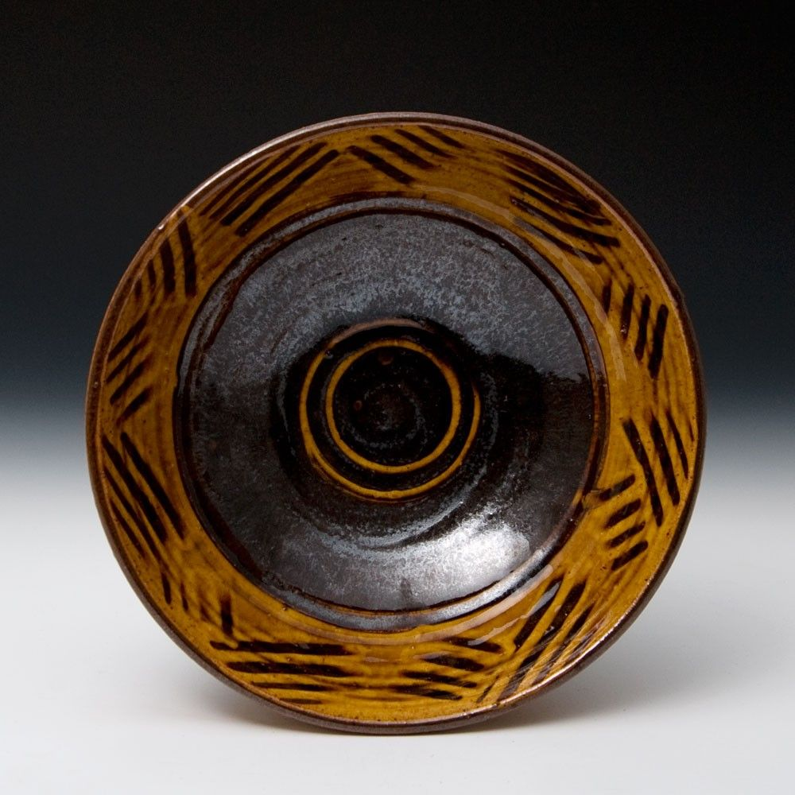

Slide 25
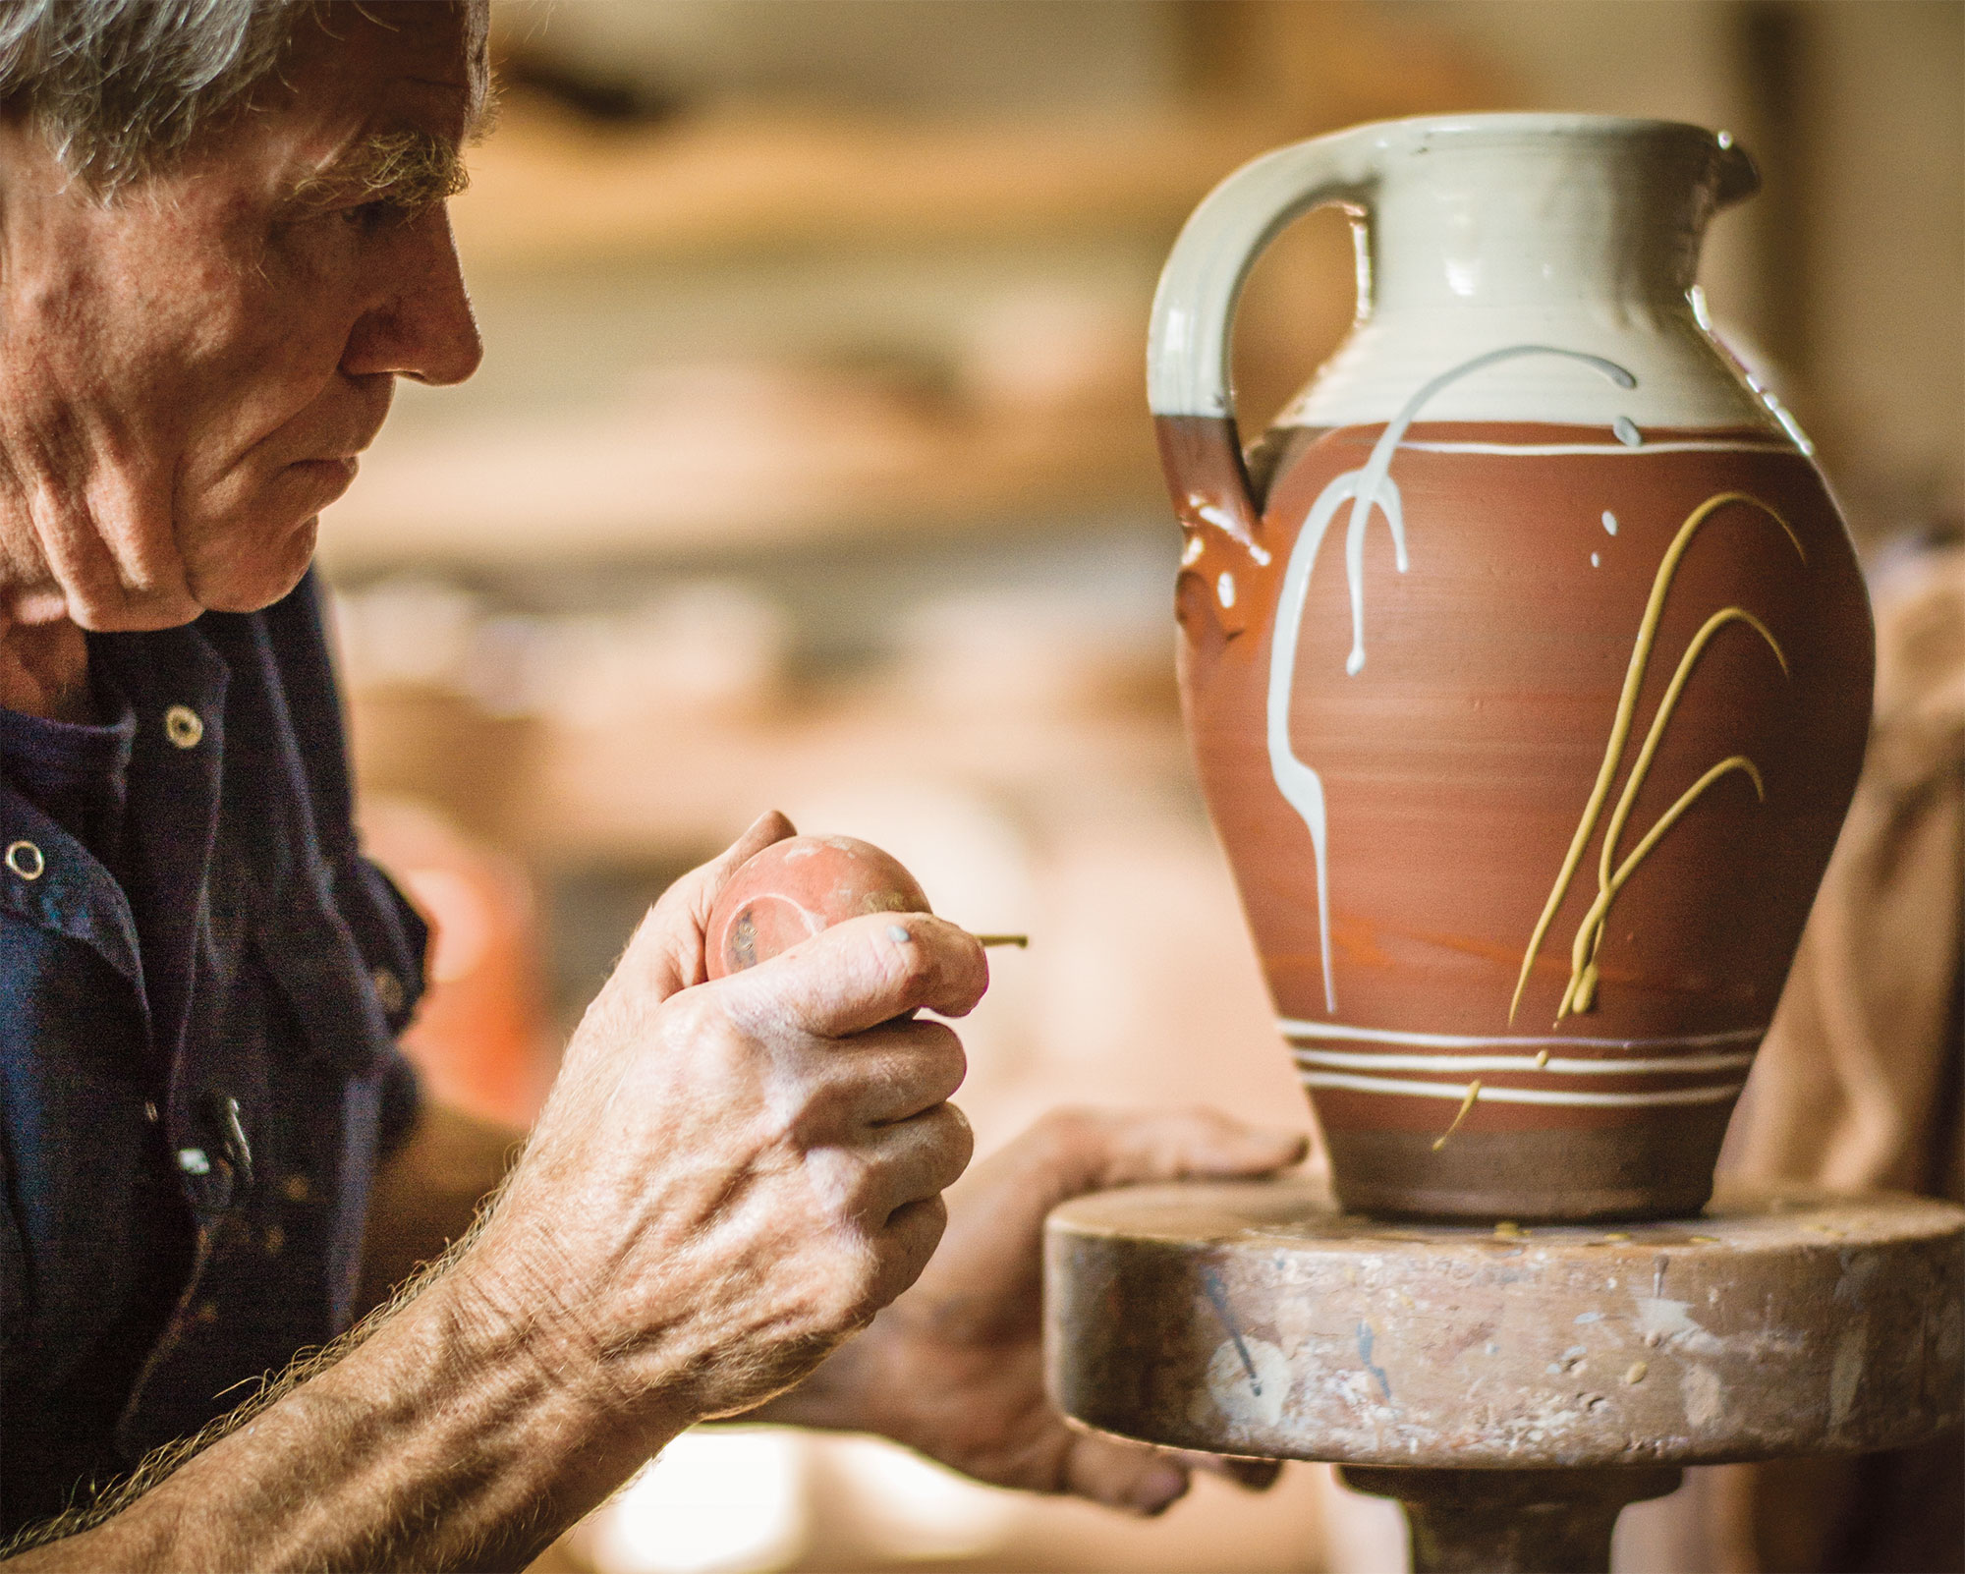

Slide 26
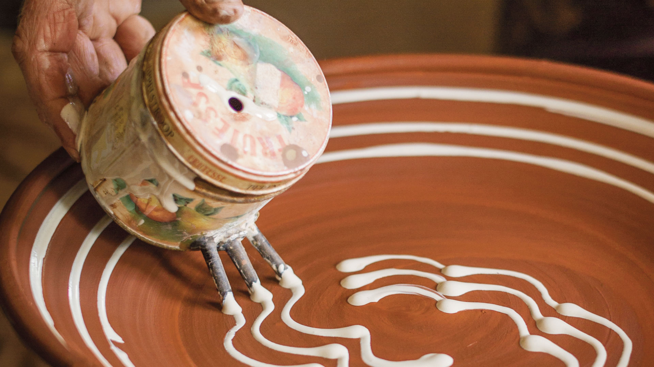

Slide 27
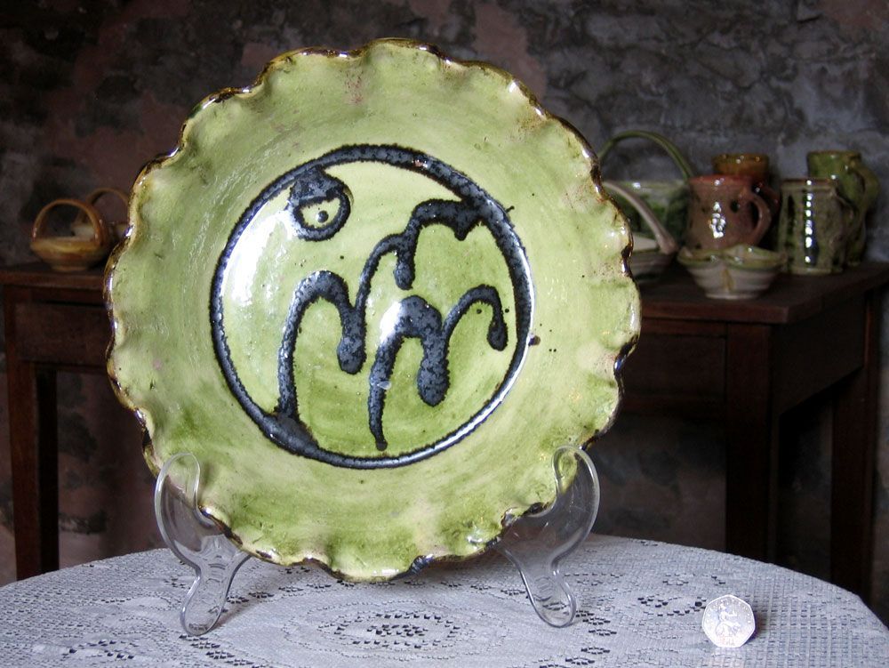
GEOFFREY FULLER

Slide 28
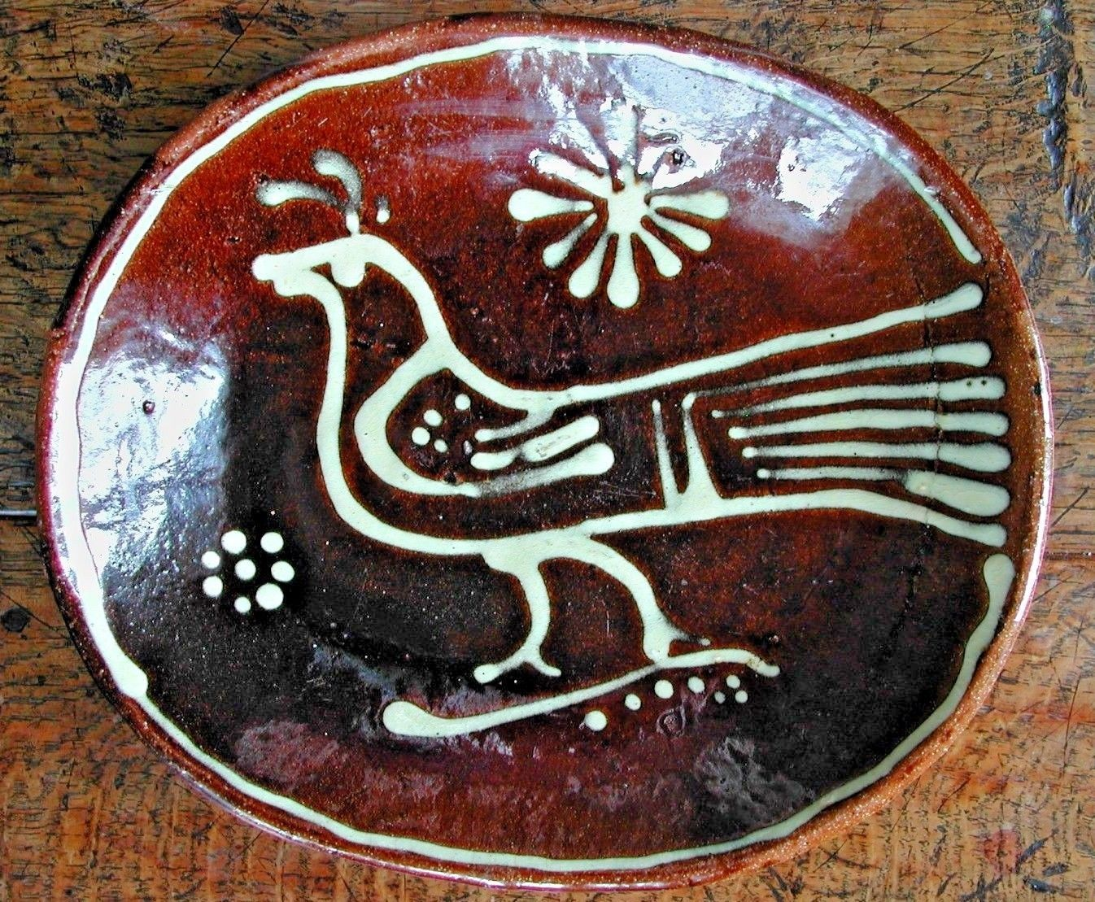

Slide 29
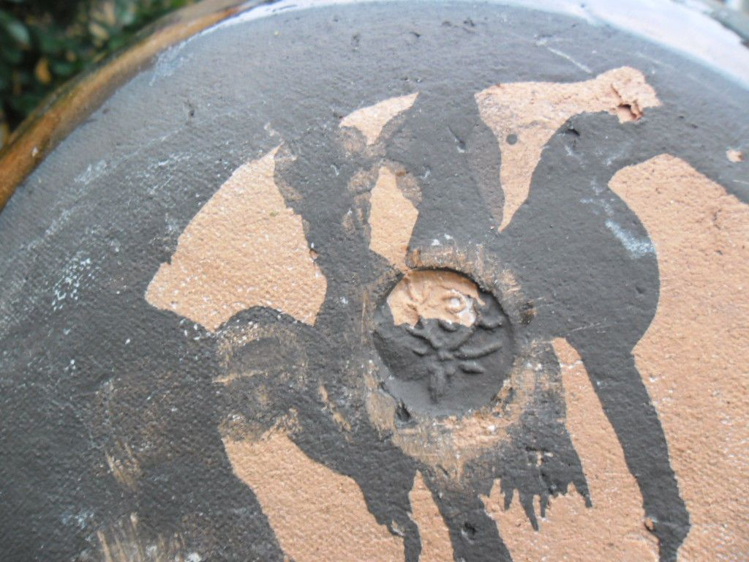

Slide 30
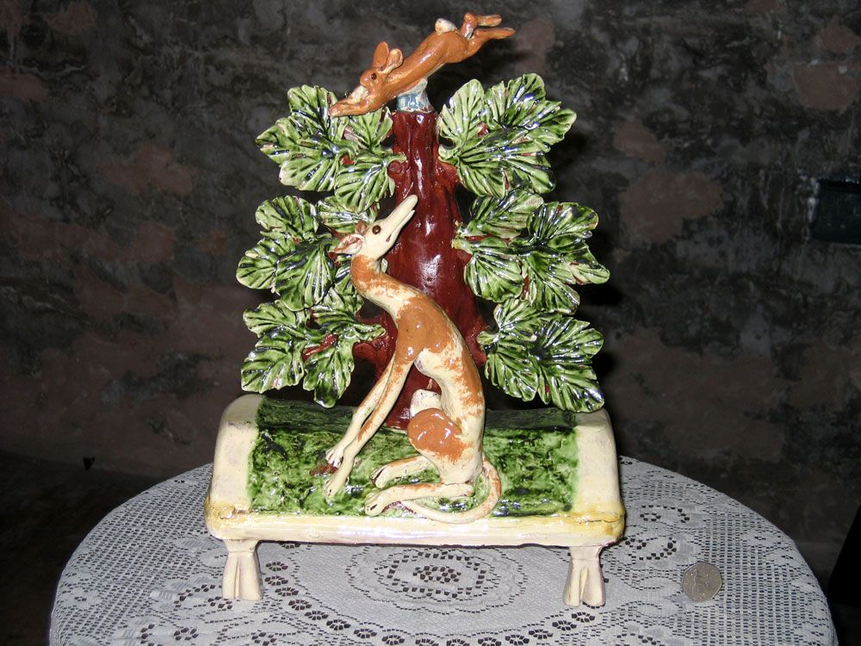

Slide 31
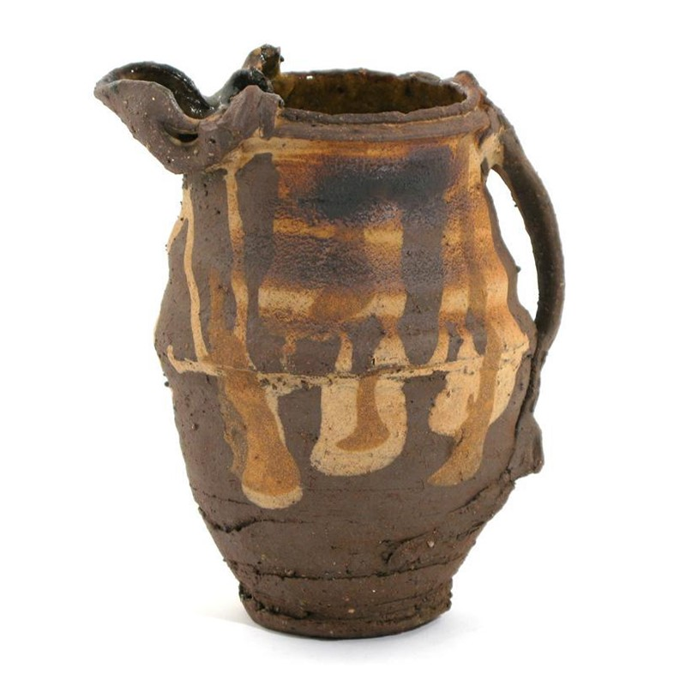
PETER SMITH

Slide 32
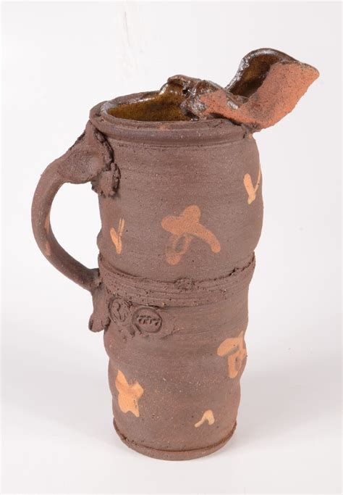

Slide 33
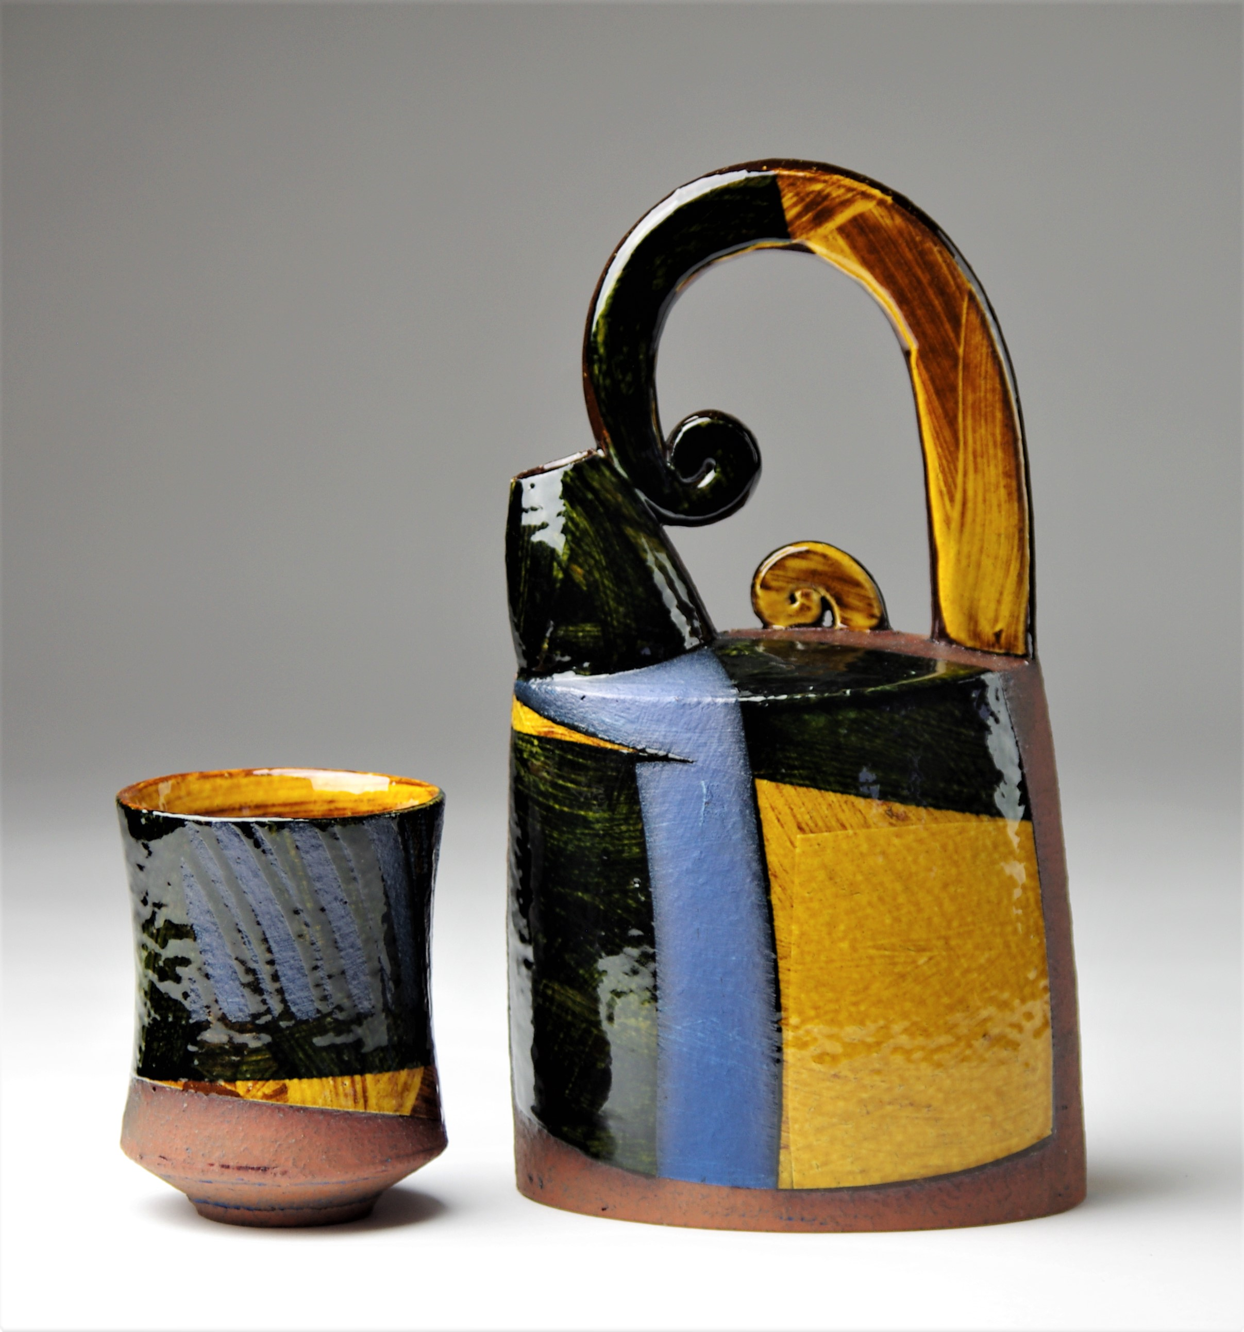
RICHARD PHETHEAM

Slide 34
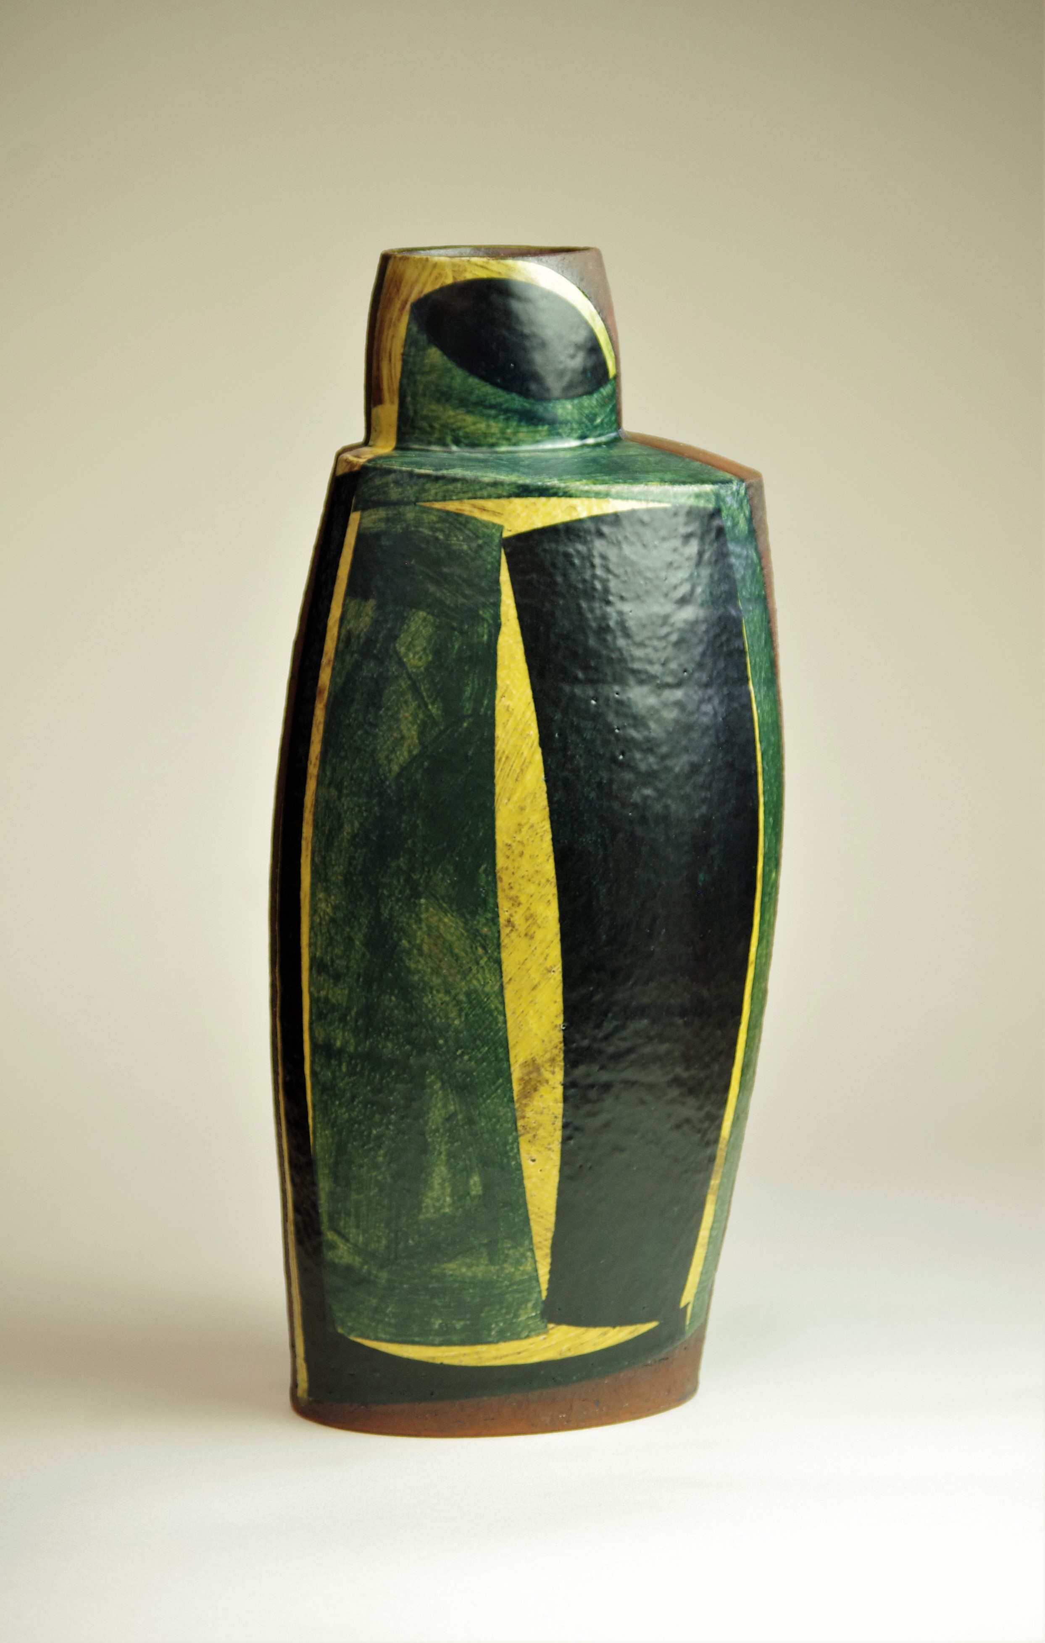

Slide 35
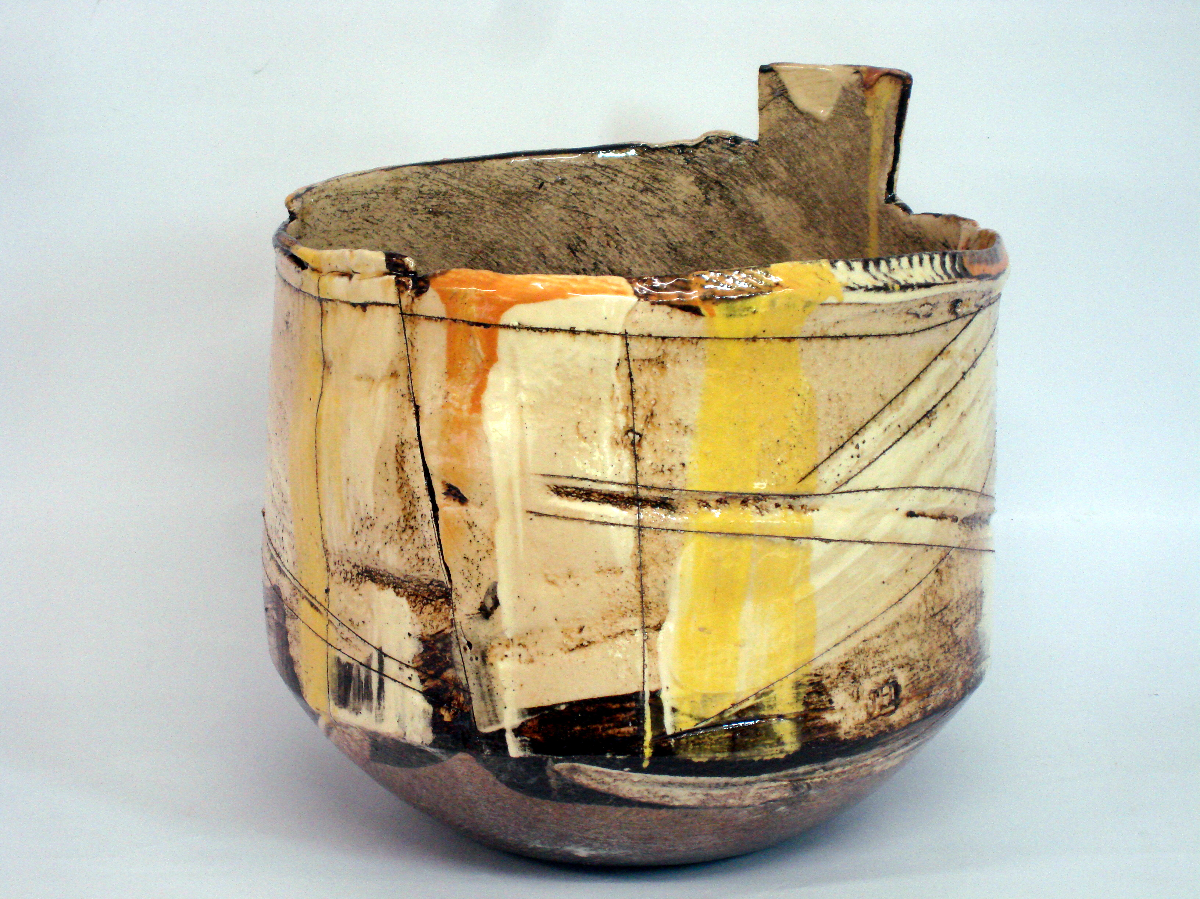
JOHN HIGGINS

Slide 36
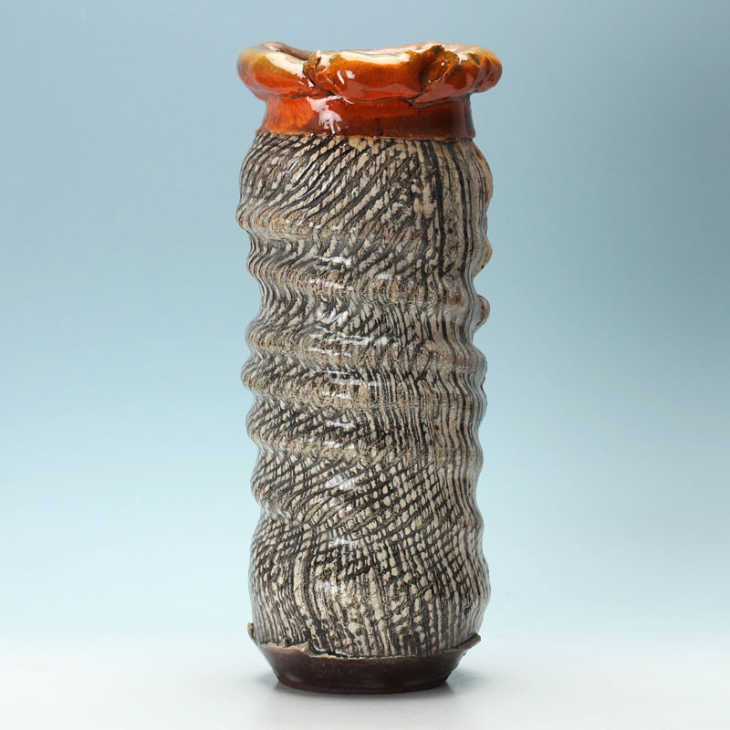

Slide 37
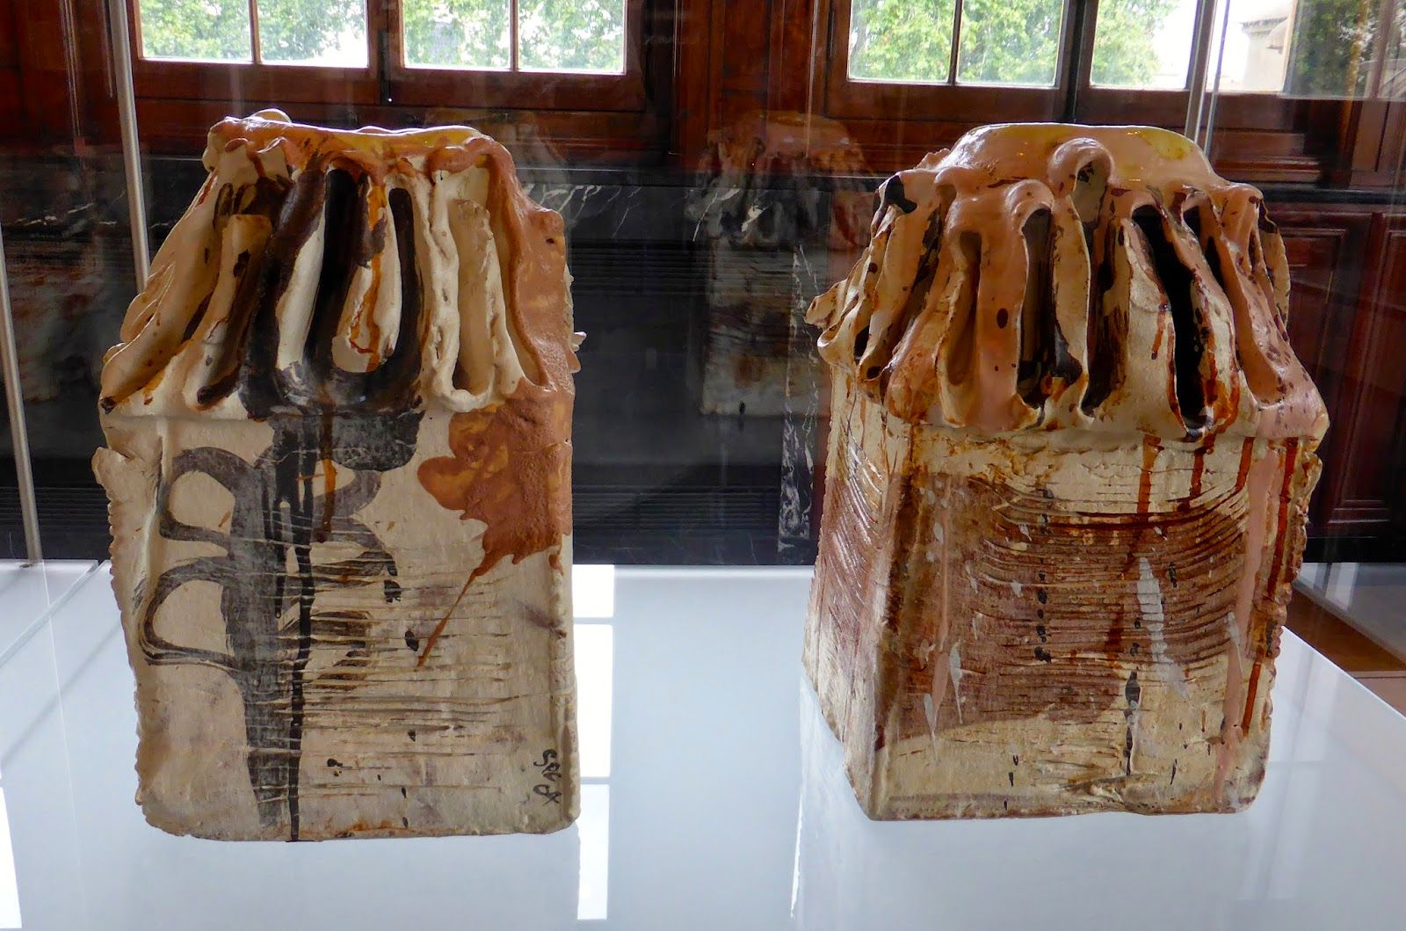
SIMON CARROL

Slide 38
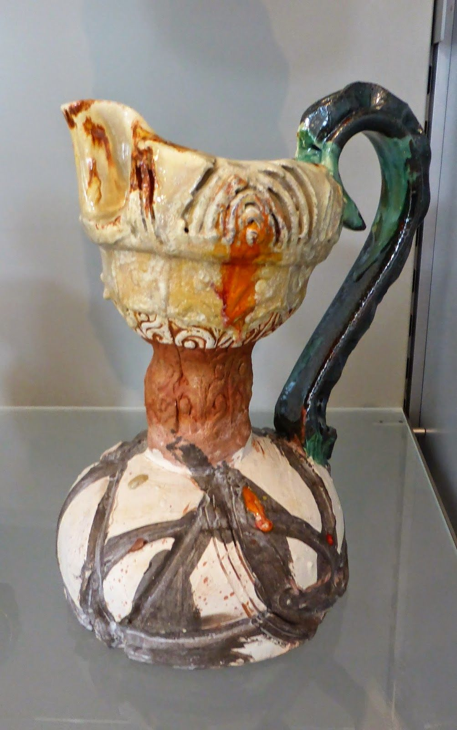

Slide 39
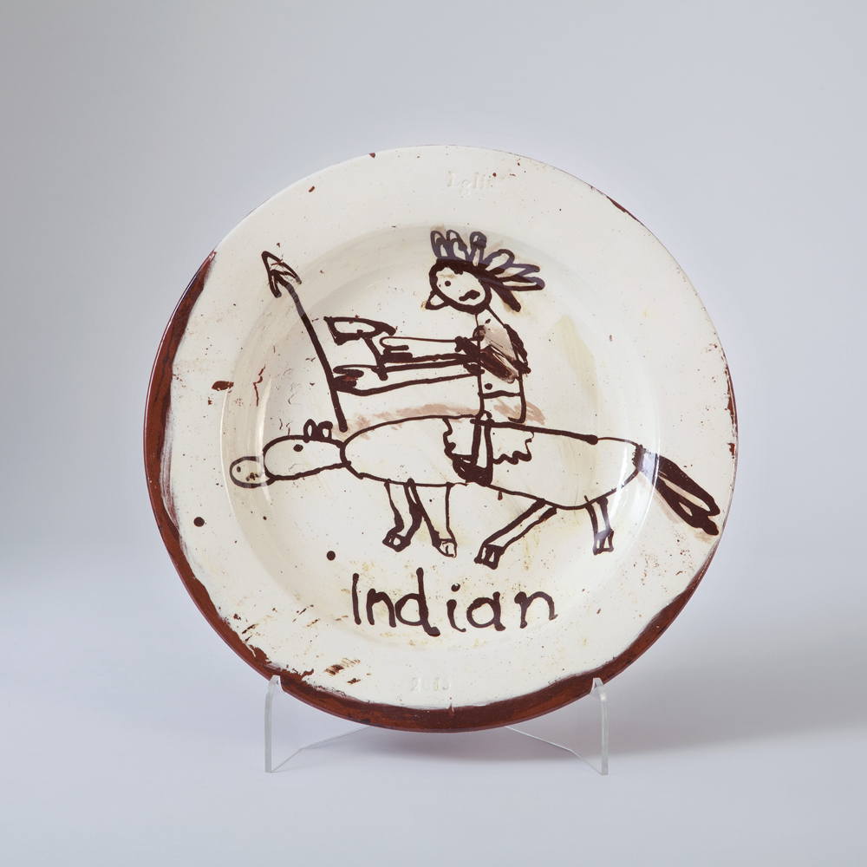
PHILIP EGGLIN

Slide 40
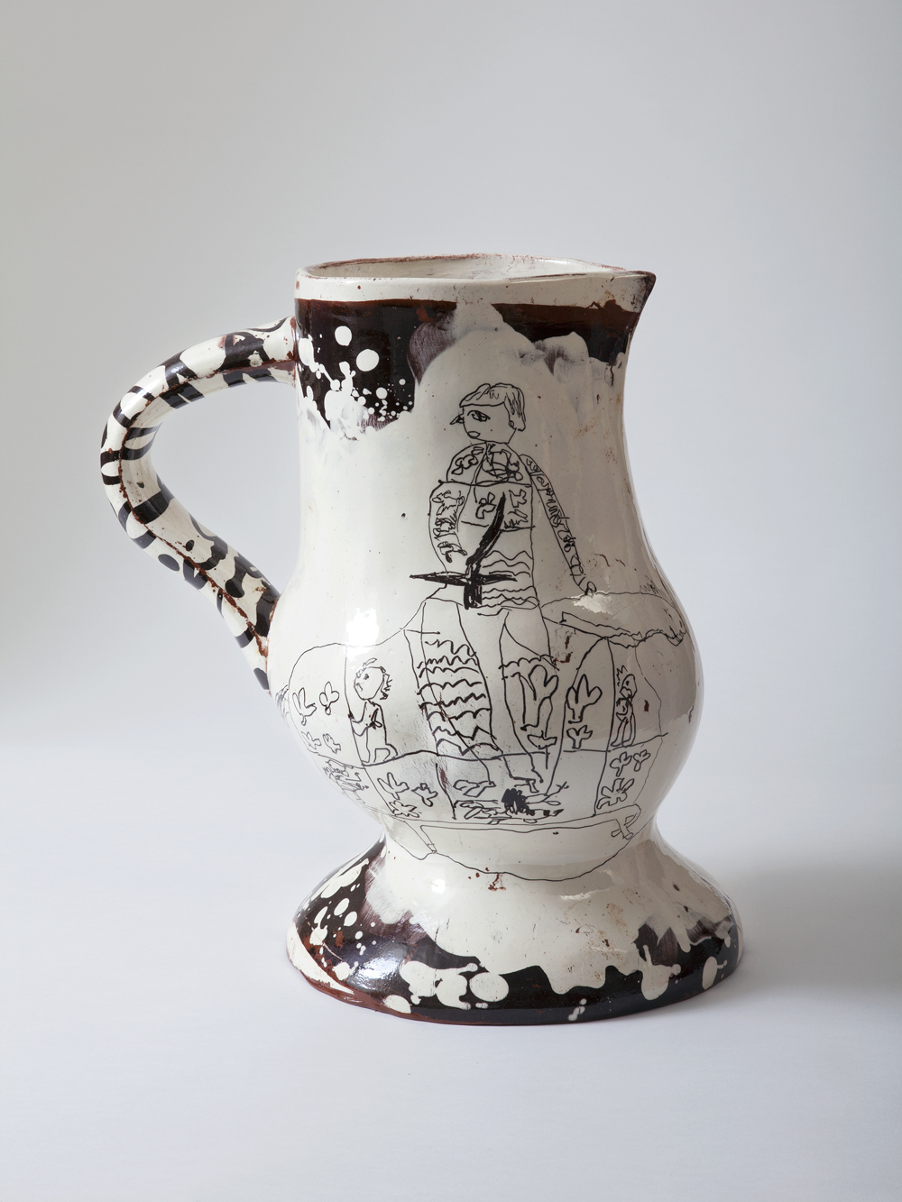

Slide 41
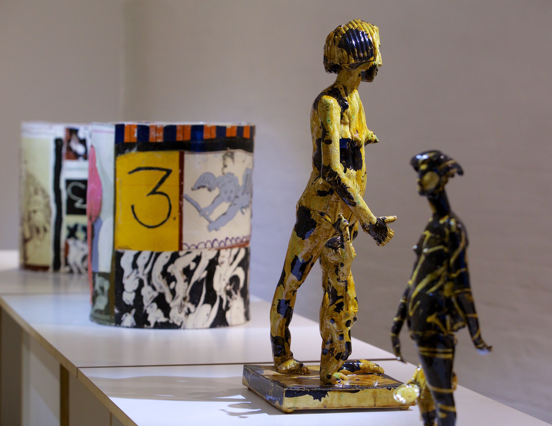

Slide 42
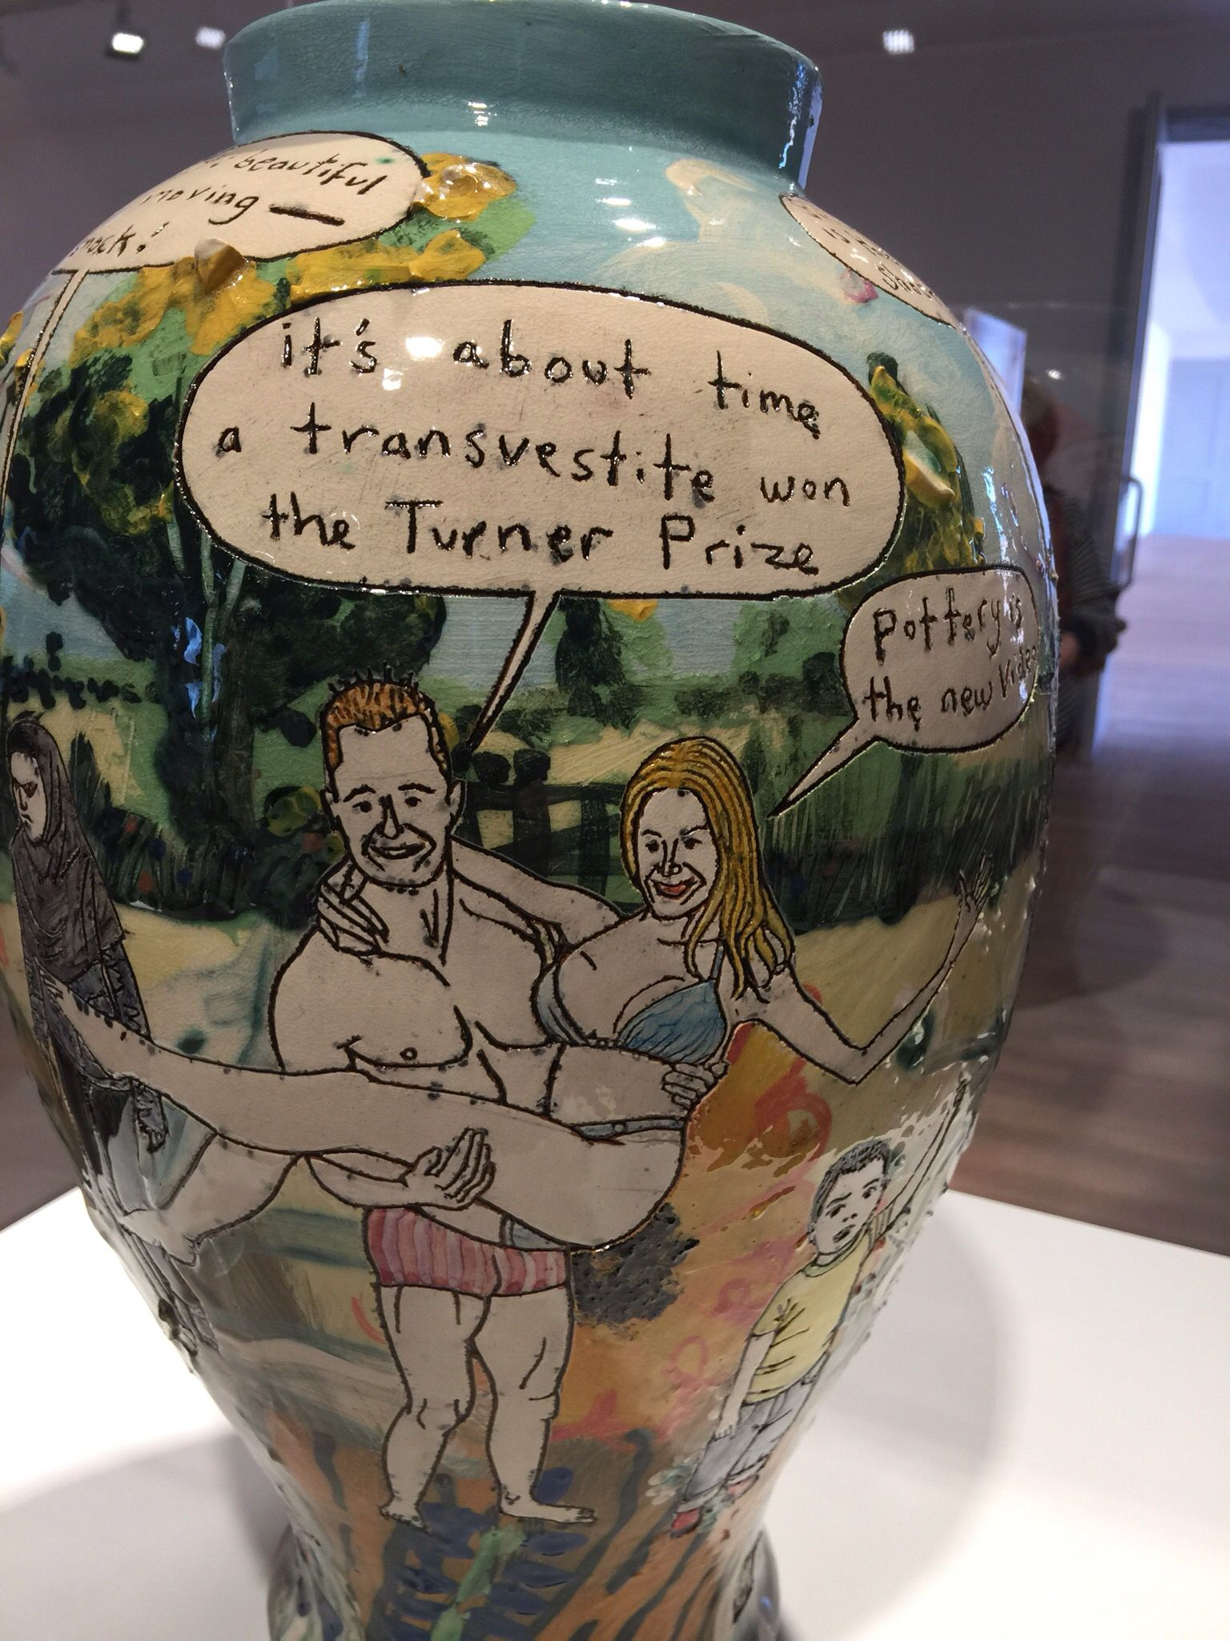
GRAYSON PERRY

Slide 43
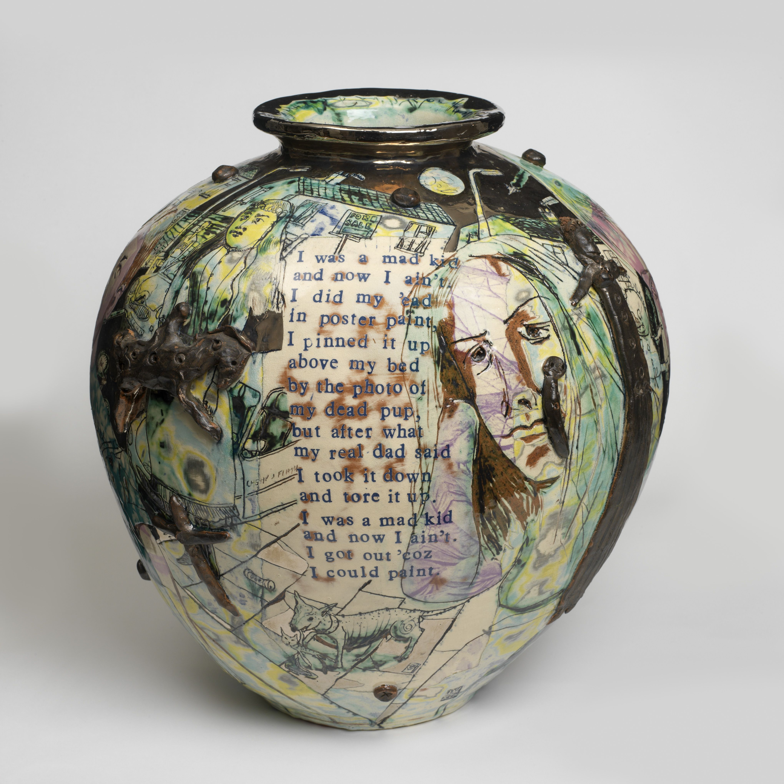

Slide 44
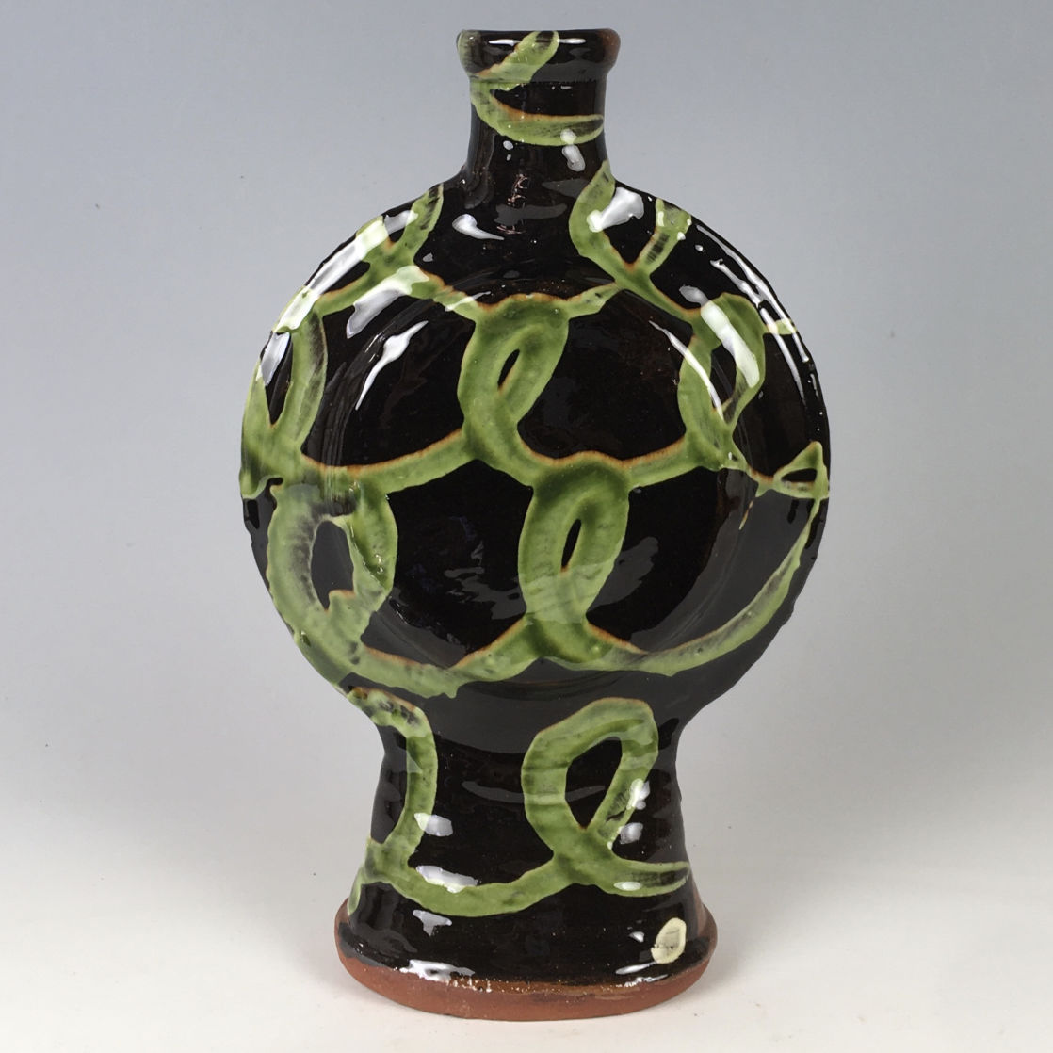
DYLAN BOWEN

Slide 45
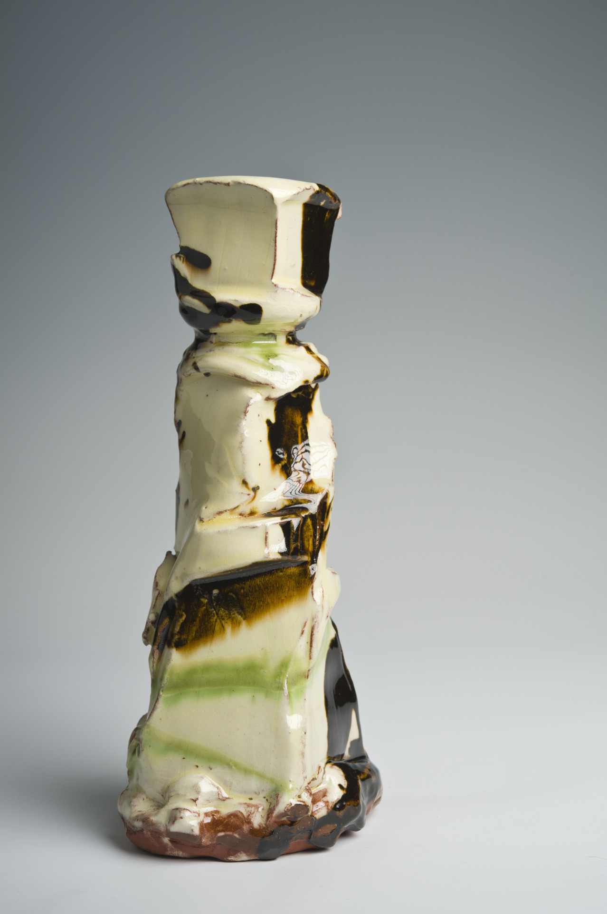

Slide 46
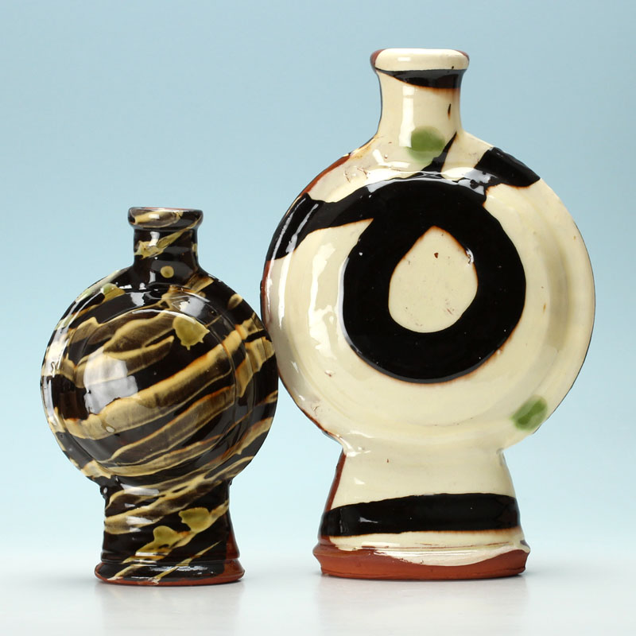

Slide 47
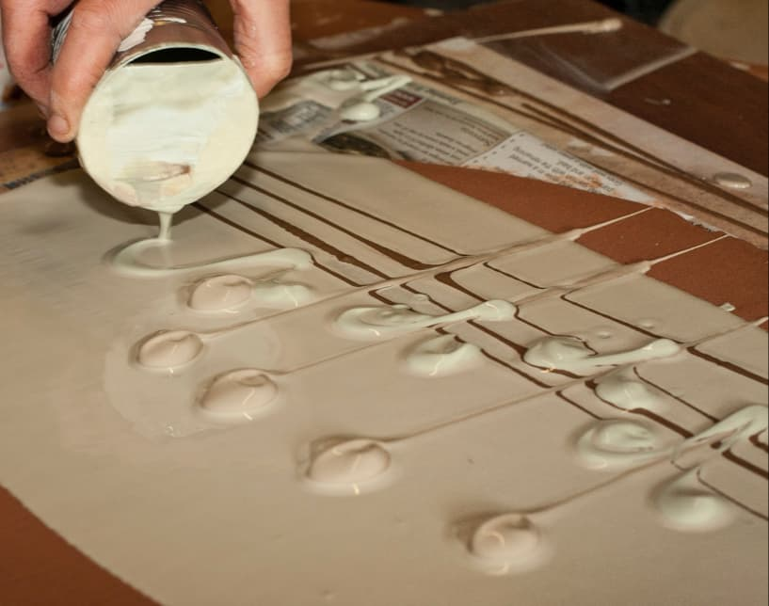
PATIA DAVIS

Slide 48
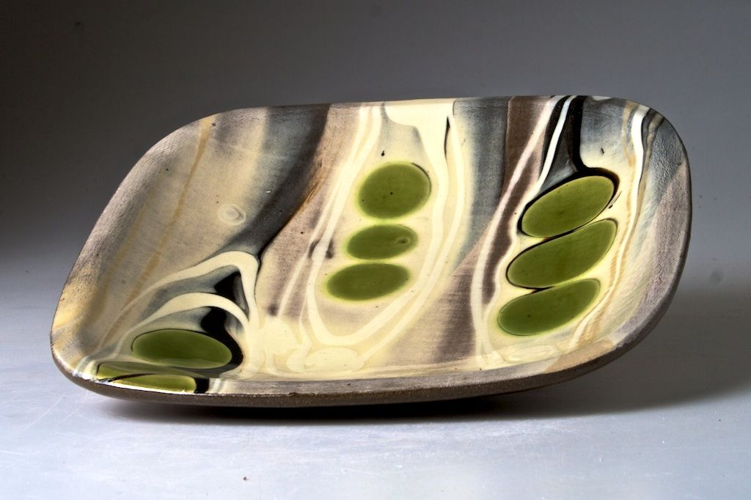

Slide 49
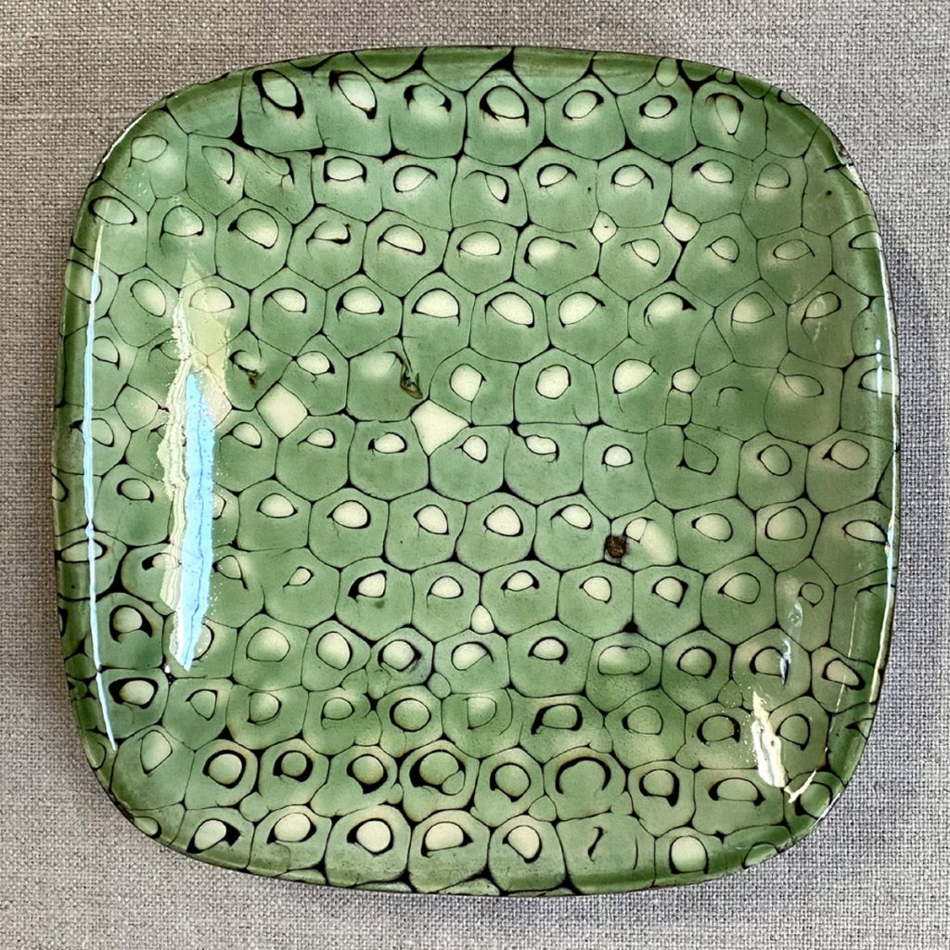

Slide 50
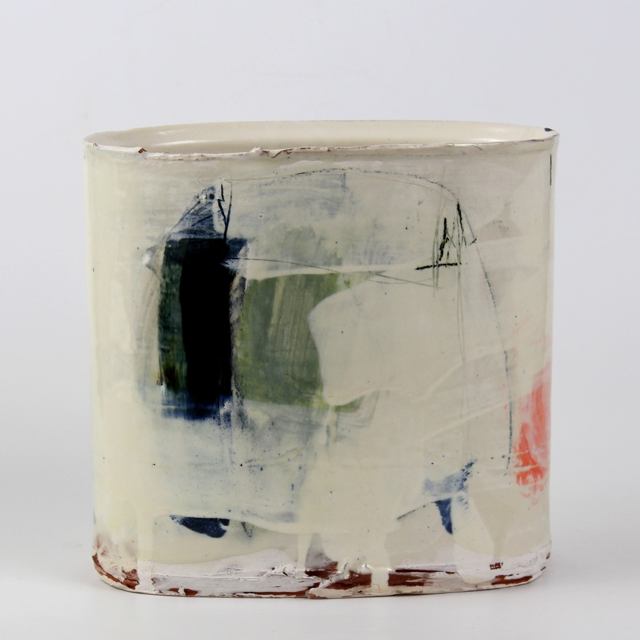
BARRY STEDMAN

Slide 51
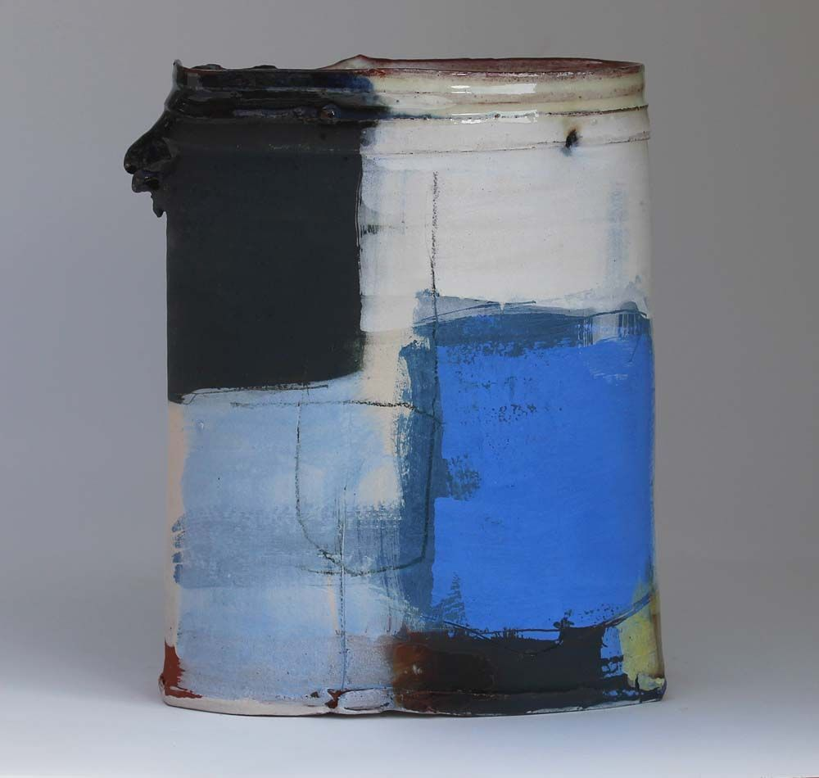

Slide 52

SVEIN NARUM

Slide 53

MARIET TINGLEFF

Slide 54


Slide 55

MARIA KRISTOFFERSON

Slide 56


Slide 57

HANS FISCHER

Slide 58


Slide 59

JOHANNES PETERS

Slide 60


Slide 61

MICHAEL SIMON

Slide 62

BANDANA POTTERY

Slide 63


Slide 64

KANG HYO LEE

Slide 65


Slide 66

BETTY WOODMAN

Slide 67


Slide 68


Slide 69


